Slide 1
HEDIS CA MCAS Measures MY2022
Kerry Brown, Clinical Quality Program Manager

Slide 2
Definitions
CA DHCS: California Department of Health Care Services
HEDIS: Healthcare Effectiveness Data and Information Set
A set of healthcare performance measures designed by the NCQA
MCAS: Medi-Cal Managed Care Accountability Set
Measures chosen by DHCS for mandated reporting to DHCS
MPL: Minimum Performance Level
CA State has chosen the 50th percentile as the MPL. Managed Care Health Plans are required to meet the MPL or face annual sanctions (fines)

Slide 3
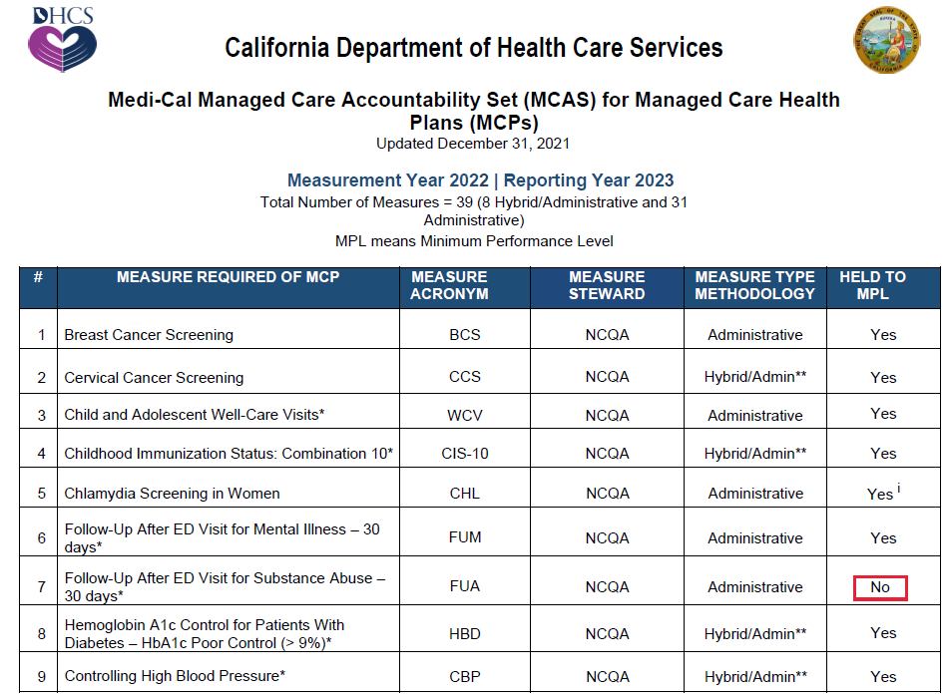
MCAS Measures
● 39 Measures currently on the MCAS list for MY2022 ● 14 Measures are held to the MPL
Notes:
Explain Administrative, Hybrid, ECDS

Slide 4
MCAS Measures

Slide 5
MCAS Measures

Slide 6
MCAS Measures

Slide 7
Focus Measures: Women
BCS: The measure looks at women 50-74 years of age who had a mammogram to screen for breast cancer during the current year or the year prior
Exclusions: Bilateral mastectomy any time during the member’s history
Discuss and screen/refer all female patients 50-74 years of age every two years
Request and retain copies of mammography results in patient’s records
Utilize EMR to create reminders for patients who need a mammogram referral during their annual visit
To exclude member from measure due to bilateral mastectomy, add history code Z90.13 to the exam visit
Best Practices:

Slide 8
Focus Measures: Women
CCS: The measure looks at women 21-64 years of age who were screened for cervical cancer using either of the following criteria:
• Women 21-64 years of age who had cervical cytology performed within the last 3 years
• Women 30-64 years of age who had cervical high-risk human papillomavirus (hrHPV) testing performed within the last 5 years
• Women 30-64 years of age who had cervical cytology/high-risk human papillomavirus (hrHPV) co-testing within the last 5 years
Exclusions: Hysterectomy with no residual cervix, cervical agenesis or acquired absence of cervix any time during the member’s history through December 31 of the measurement year
Best Practices:
Refer patients to another appropriate provider if your office does not perform Pap test and request copies of Pap test/HPV test results and enter results into member’s medical record
Utilize EMR to create reminders for patients who need Pap test/HPV test
Document member reported data in medical record, document the date and result of the exam
Document member reported total hysterectomy, with complete details and date in medical record.
If member’s cervix is absent, utilize history code, add to an annual well-woman exam to appropriately exclude patient from the measure (codes listed in coding booklet)

Slide 9
Focus Measures: Women
PPC: The measure looks at Prenatal and Postpartum Care
• Timeliness of Prenatal Care: The percentage of deliveries that received a prenatal care visit in the first trimester
• Postpartum Care: The percentage of deliveries that had a postpartum visit on or between 7 and 84 days after delivery
Best Practices:
Call patients to schedule the postpartum visits
Educate the member on the importance of prenatal and postpartum visits, for the mother and the baby
Document completely on the ACOG sheets and include fundal height
CHL: The measure looks at women 16-24 years of age who were identified as sexually active and who had at least one test for chlamydia during the measurement year
Best Practices:
Consider adding chlamydia screening to the annual preventative services list for females ages 16-24
Urine screening for chlamydia is acceptable to meet screening compliance.
Take a sexual history when you see adolescents.

Slide 10
Focus Measures: Chronic Conditions
HBD: The measure looks at members 18-75 years of age with diabetes (types 1 and 2) whose hemoglobin A1c (AbA1c) was at >9.0% levels during the measurement year. ***A lower rate indicates better performance for this indicator (i.e., low rates of poor control indicate better care).
Best Practices:
Have reminders set in your EMR System to alert when member’s screenings are due
Record lab test results in the member’s chart
Consider sending Anthem supplemental EMR data to include A1c results
CBP: The measure looks at members 18-85 years of age who had a diagnosis of hypertension and whose BP was adequately controlled (<140/90 mm Hg) during the measurement year
Best Practices:
Take members BP during every visit, if elevated retake later in the visit, record both readings
Make a variety of cuff sizes available
Warn staff against rounding BP results
Educate members on healthy lifestyle and importance of taking all prescribed medications as directed
Telehealth visits, if member has an electronic blood pressure cuff the provider may put the specific BP in the member’s medical record

Slide 11
Focus Measures: Children
LSC: The measure looks at children 2 years of age who had one or more capillary or venous lead blood test for lead poisoning by their second birthday
Best Practices:
CIS-10: The measure looks at members who turn 2 years old in the measurement year and received all required immunizations
Best Practices:
Record immunizations in your state immunization registry including the birth Hepatitis B
Document immunizations (historic or current) within medical records
Code services correctly, use procedure codes to document immunizations (see coding booklet)
IMA: The measure looks at children/adolescents both male and female 9-13 years of age who received the required immunizations
Best Practices:
Record immunizations in your state immunization registry including the birth Hepatitis B
Document immunizations (historic or current) within medical records
Code services correctly, use procedure codes to document immunizations (see coding booklet)
Follow the DHCS All Plan Letter (APL 20-016)
Notes:
Bright Futures/AAP periodicity chart for 2022.
HEDIS follows the same guidance for children’s measures.

Slide 12
Focus Measures: Children
W30: The measure looks at members who had the following number of well-child visits with a PCP during the last 15 months:
• Children who turned 15 months old during the measurement year: Six or more well-child visits
• Children who turned 30 months old during the measurement year: Two or more well child visits
Best Practices:
WCV: The measure looks at members 3-21 years of age who had at least one comprehensive well-care visit with a PCP or an OB/GYN practitioner during the measurement year
Best Practices:
Document each well visit in the member’s medical record, be sure to document any advice given
Utilize the appropriate HEDIS acceptable codes when billing services
Document each well visit in the member’s medical record, be sure to document any advice given
Utilize the appropriate HEDIS acceptable codes when billing services
Notes:
Bright Futures/AAP periodicity chart for 2022.
HEDIS follows the same guidance for children’s measures.

Slide 13
Tools and Resources
Anthem’s HEDIS
Coding Booklet
Anthem’s HEDIS
Quick Reference Guides for
Children and Adults
EMR Access
MRDB Submissions
(Medical Record Database)

Slide 14
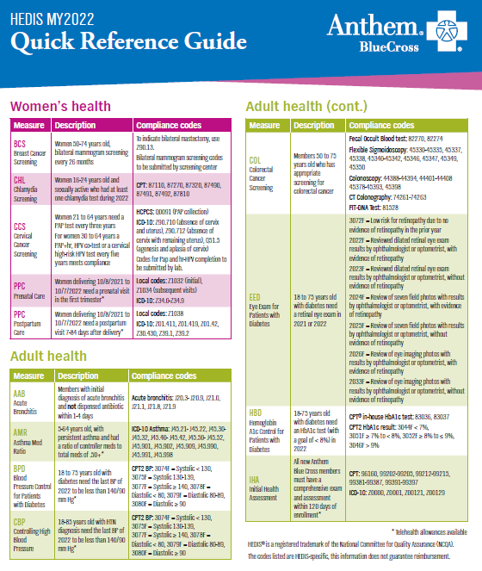
Coding Aides

Slide 15
EMR Access
Remote EMR Access to Anthem Blue Cross HEDIS Team
Benefits include:
Assist clinic sites on closing gaps year round
For HEDIS and other audits, Anthem does not have to occupy your office space when onsite appointments are set up
Anthem will not have to call and request records from your office when additional information is required
Your office will not be affected and can carry on with your daily duties in providing excellent care – our staff can do all the necessary research from an Anthem office
Anthem staff are trained in HEDIS and know what is required in the record
Potential gaps in the exchange of data between your office and Anthem can be discovered and managed
Potential omissions in our office reports can be discovered and managed

Slide 16
MRDB Submissions
MRDB is an internal Anthem database used to enter medical record information that will become non-standard supplemental data
All non-standard supplemental data must be substantiated by proof of service documentation from the legal health record (e.g. medical record)
Data entered into MRDB is used for administrative benchmarks, GIC reports and HEDIS sample rates, the information is reflected monthly in the HEDIS data

Slide 17
What can be submitted to Anthem for potential MRDB submission?
CCS: Cervical Cancer Screenings
PAP test (1/2020 through 12/2022)
PAP +/or HPV test (1/2018 through 12/2022)
Total Hysterectomy or other absence of cervix procedures for exclusion
BCS: Breast Cancer Screening
Bilateral mammogram (10/2020 through 12/2022)
History of Double Mastectomy for exclusion
HBD A1c: Hemoglobin A1c Control for Patients with Diabetes – HbA1c Poor Control (>9%)
A1c Results (01/2022 through 12/2022)
W30*: Well-Child Visits in the First 30 Months of Life
Well Visit (1/2022 through 12/2022)
*Please work with Julie Atchley and Kerry Brown directly on this measure

Slide 18
How to submit records for MRDB submission
Work with your Anthem contact
or
Reach out directly to Julie Atchley and Kerry Brown to discuss submissions
Julie.Atchley@Anthem.com
Kerry.Brown@Anthem.com

Slide 19
Questions/Answers

