Slide 1
Chronic Care Management for the Rural Health Clinic: Best Practices, Lessons Learned, and Optimizing Outcomes
Presented by:
Faith Jones, MSN, RN, NEA-BC
Director of Care Coordination and Lean Consulting at HealthTech
&
Chandra Donnell, Vice President
Business Development at CrossTx
July 2022

Slide 2
Objectives
Following this session, the participant will:
Understand the rationale for implementing care coordination in Rural Health Clinics
Explain the revenue generation and advantages for care coordination
Understand that care management services in a RHC includes chronic care management, behavioral health integration, and principal care management.

Slide 3
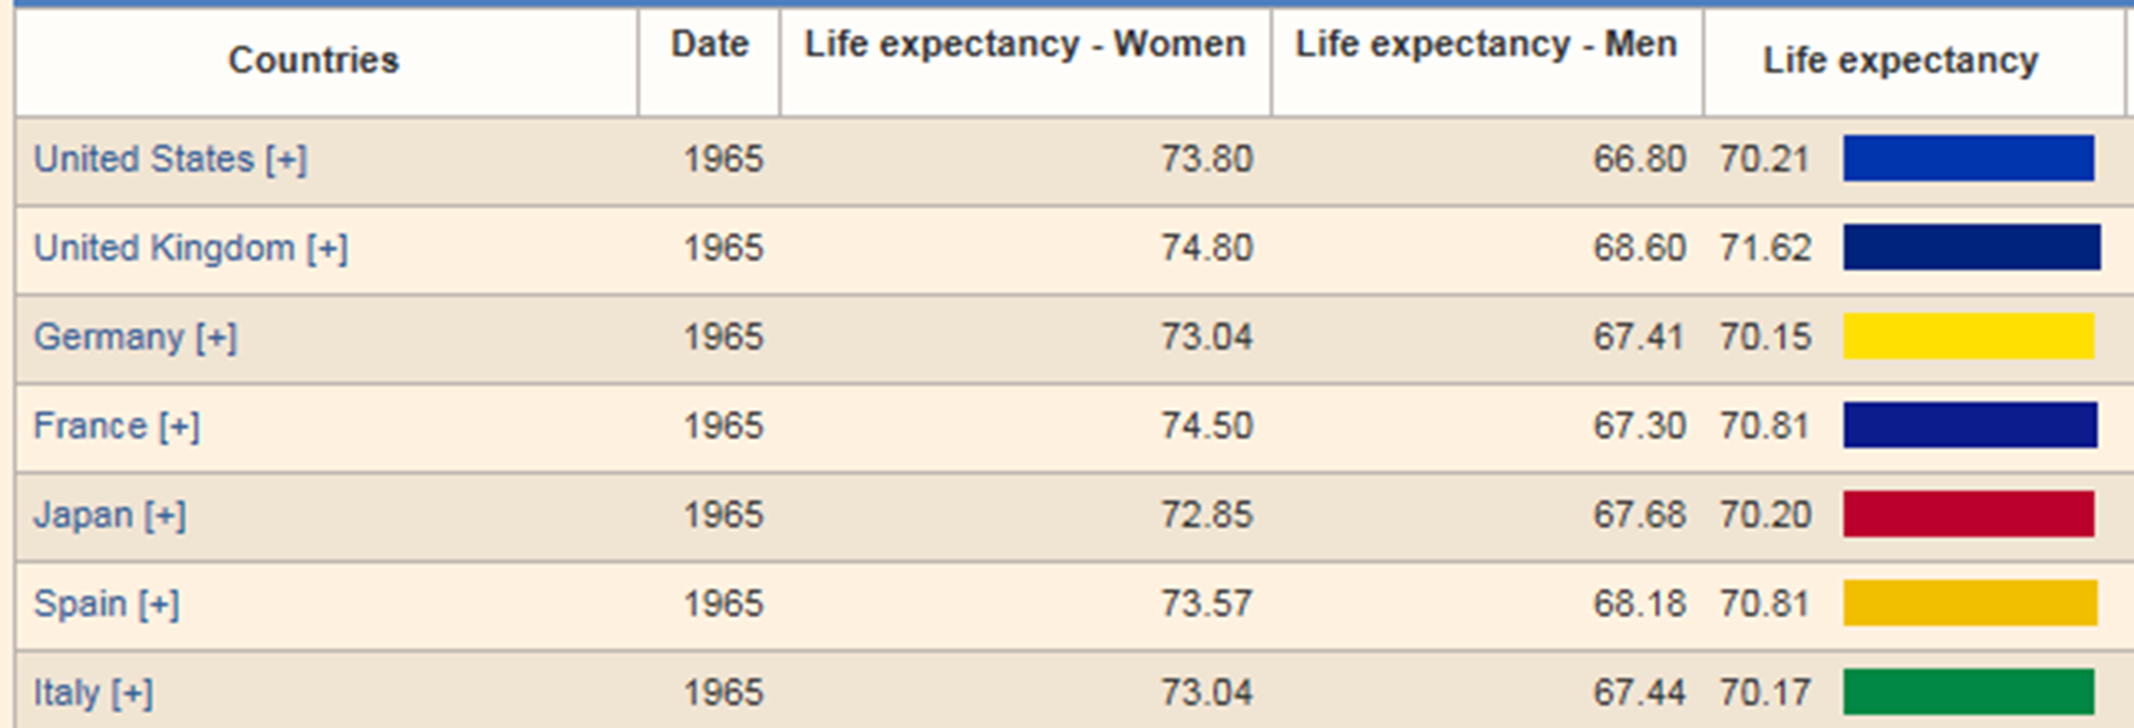
Inception of Medicare
https://countryeconomy.com/demography/life-expectancy?year=1965

Slide 4
Change from Sick Care to Wellness and Prevention
Medically Necessary
Since its inception Medicare coverage focused on treating beneficiaries’ conditions and diseases
The Affordable Care Act – made a significant change
As of January 2011, Medicare beneficiaries began receiving the new benefit of a FREE Annual Wellness Visit

Slide 5
The Transition Requires Transformation
“Our goal is to recognize the trend toward practice transformation and overall improved quality of care, while preventing unwanted and unnecessary care”
CMS CFR 11-12-2014

Slide 6
Care Delivery Models
“…new and evolving care delivery models, which feature an increased role for non-physician practitioners (often as care coordination facilitators or in team-based care) have been shown to improve patient outcomes while reducing costs, both of which are important Department goals as we move further toward quality- and value-based purchasing of health care services in the Medicare program and the health care system as a whole.”
Vol. 80 Wednesday, No. 135 July 15, 2015, P 226

Slide 7
Care Delivery Models
“We acknowledged that the care coordination included in services such as office visits does not always describe adequately the non-face-to-face care management work involved in primary care and may not reflect all the services and resources required to furnish comprehensive, coordinated care management for certain categories of beneficiaries”
CMS CFR 7-15-2015

Slide 8
Team-Based Care
Shared Goals
Clear Roles
Mutual Trust
Effective Communication
Measurable Processes
and Outcomes
https://encrypted-tbn0.gstatic.com/images?q=tbn:ANd9GcQSfxK_VwmoKnWIsWC9daOFJu-j9HV7e64cUg&usqp=CAU

Slide 9
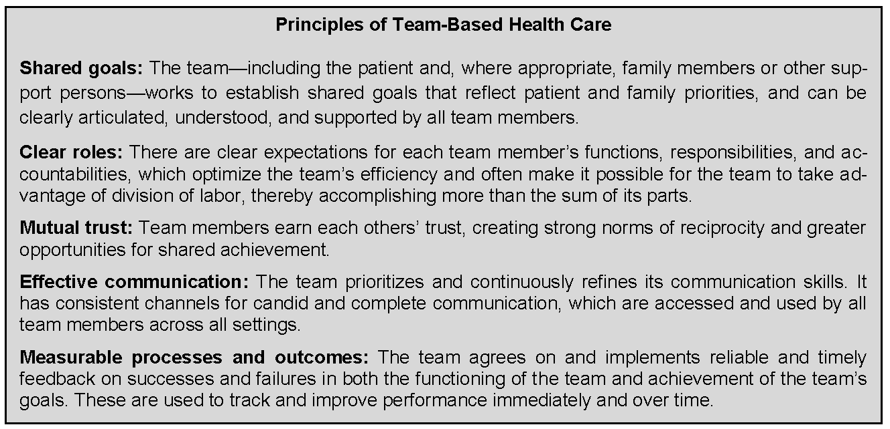
Team-Based Care
https://nam.edu/perspectives-2012-core-principles-values-of-effective-team-based-health-care/

Slide 10
Quadruple Aim

Slide 11
Care Coordination Growth and Development
2013/2015: TCM / CCM Care Management
2016: Chronic Care Management for RHCs and FQHCs and Advance Care Planning
2017: Complex CCM, Behavior Health Integration, Collaborative Care Management 2018: RHC and FQHC Care Management and the Diabetes Prevention Program
2019: Team based Documentation, Chronic Care Remote Physiological Monitoring (CCRPM)
2020: Additional Time allowed for CCM, Expand to allow for billing of concurrent services, Principal Care Management (PCM)
Added additional units for CCRPM
2021: Change the G-Code to CPT for additional time for CCM
Added a G code for 30 min of CoCM
Changed CCRPM to RPM
2022: Change the G-Code to CPT for PCM and added additional units for PCM
Team Based Care
AWV 2011

Slide 12
How Well is Care Coordination Working?
“…CMS estimated that approximately 3 million unique beneficiaries (9% of the Medicare FFS pop) received [care coordination] services annually, with a higher use of CCM, TCM and advance care planning services”
Noted outcomes:
“reduced readmission rates, lower mortality, and decrease health care costs”
Vol. 84, No. 221/Friday, November 15, 2019/Rules and Regulations p.62685

Slide 13
Patient Engagement
This Photo by Unknown Author is licensed under CC BY

Slide 14
Team Based Care Services
Annual Wellness Visit (AWV)
Advance Care Planning (ACP)
Transitional Care Management (TCM)
Chronic Care Management (CCM)
Behavioral Health Integration (BHI)
Principal Care Management (PCM)
Remote Physiological Monitoring (RPM)
Alphabet Soup

Slide 15
Health is what the individual believes it is
Health Promotion and Health
Proactive Care Coordination
Is
Health Promotion

Slide 16
Elements of Chronic Care Management
Practice Eligibility
Patient Eligibility
Qualified EMR
Availability of electronic communication with patient and care giver
Collaboration and electronically communication with community resources & referrals
After hours coverage
Care Plan Access
Primary Care Provider general supervision of clinical staff
Medicare Patients (others also)
Two or more chronic conditions expected to last at least 12 months or until the death of the patient
At significant risk of death, acute exacerbation, decompensation, or functional decline without management
Patient Consent
CCM initiated by the primary care provider
Time tracking of at least 20 min per calendar month

Slide 17
Behavioral Health Integration vs Integrated Behavioral Health
Terminology Matters
BHI – Behavioral Health Integration
Care Coordination Model
IBH – Integrated Behavioral Health
Care Delivery Model
This Photo by Unknown Author is licensed under CC BY-SA
This Photo by Unknown Author is licensed under CC BY-NC-ND

Slide 18
Elements of Behavioral Health Integration
Service Components
Patient Eligibility
BHI initiated by the primary care provider
Initial assessment
Initiating visit (if required, separately billed)
Administration of applicable validated rating scale(s)
Systematic assessment and monitoring, using applicable validated clinical rating scales
Care planning by the primary care team jointly with the beneficiary, with care plan revision for patients whose condition is not improving
Facilitation and coordination of behavioral health treatment
Continuous relationship with a designated member of the care team
Medicare Patient
“Any mental, behavioral health, or psychiatric condition being treated by the billing practitioner, including substance use disorders, that, in the clinical judgment of the billing practitioner, warrants BHI services. The diagnosis or diagnoses could be either pre-existing or made by the billing practitioner and may be refined over time”.
Patient Consent
Documentation of at least 20 minutes per calendar month
https://www.cms.gov/Outreach-and-Education/Medicare-Learning-Network-MLN/MLNProducts/Downloads/BehavioralHealthIntegration.pdf

Slide 19
Patient Eligibility Comparing CCM and BHI
CCM
General BHI
Medicare Patient
2 Chronic Conditions – determined by PCP
Patient Consent (verbal or written)
CCM initiated by the primary care provider
At a visit
Visit not required for “established patient” Established = seen in 12 months
Plan of Care
Documentation of at least 20 minutes per calendar month
Medicare Patient
1 Behavioral Health Diagnosis – determined by PCP
Patient Consent (verbal or written)
BHI initiated by the primary care provider
At a visit
Visit not required for “established patient” Established = seen in 12 months
Plan of Care including rating scale
Documentation of at least 20 minutes per calendar month

Slide 20
PCM in Primary Care
Under the Right Circumstances
One serious chronic conditions
OR
high-risk disease expected to last between 3 months and a year or until the death of the patient
Condition may have led to a recent hospitalization or places patient at significant risk of hospitalization, death, acute exacerbation, decompensation, or functional decline without management

Slide 21
Rural Health & Federally Qualified Health Clinics
BHI
CCM
PCM
Care Management
Billing code G0511

Slide 22
Purpose of Care Coordination
Care Coordination is more than time tracking
More than just calling your patients
This Photo by Unknown Author is licensed under CC BY-NC-ND

Slide 23
Getting Organized
Start by looking at the last visits
This Photo by Unknown Author is licensed under CC BY-SA

Slide 24
Research and Follow Up
Were there any tests ordered?
What did the results show?
Will they need to be redone? When?
Follow up appointment?
When is it scheduled for?
What is the plan?

Slide 25
No Duplication of Work
Document the research you have done
and the plan for the future.
This Photo by Unknown Author is licensed under CC BY-NC-ND

Slide 26
Capture your Research
Planning for the future
Using the right tools
This Photo by Unknown Author is licensed under CC BY
This Photo by Unknown Author is licensed under CC BY-NC
This Photo by Unknown Author is licensed under CC BY-SA-NC

Slide 27
How to Evaluate a Care Coordination Program Vendor?
Start with Questions about all Care Coordinated Programs
Are you able to assist us with tracking patients for
Chronic Care Management?
Complex Chronic Care Management?
Behavioral Health Integration?
Collaborative Care Management?
Principal Care Management?
Remote Physiological Monitoring?
Transition of Care Management
ACO populations or groups?
Referral management?
Discharge management?
This Photo by Unknown Author is licensed under CC BY-SA

Slide 28
How to Evaluate a Care Coordination Program Vendor?
Data Management Questions
How will you integrate with my EHR? How many of your clients integrate or use as a standalone product?
How will you extract demographic information from the EHR?
Will we have an audit trail of patient encounters?
This Photo by Unknown Author is licensed under CC BY

Slide 29
How to Evaluate a Care Coordination Program Vendor?
Onboarding and Training Questions
Can you help us identify the best types of individuals that excel at the care coordination role?
What will you expect of our clinic and hospital for training?
How do you set up your organizations for success? Do you have any additional support and training after implementation?
Explain the process you use to explain each program to patients?
Explain the process you use to explain consent to patients?
What percentage of patients do you expect to enroll into your care coordinated program?
What type of care plan do you use for the “patient-centered care plan?” Can you demonstrate it for us.
Will my providers ever have to leave the EHR?
This Photo by Unknown Author is licensed under CC BY-NC-ND

Slide 30
How to Evaluate a Care Coordination Program Vendor?
Bidirectional Communication Questions
How do you connect to our community resources?
Do we have a HIPAA compliant, electronic way to communicate with community resources?
How do you communicate with patients, care givers, family members?
Can you accommodate bidirectional exchange of care plans and other information with the care coordinated patient?
Do we have a HIPAA compliant, electronic way to communicate with patients, care givers, family members individually and amongst groups?
This Photo by Unknown Author is licensed under CC BY-SA

Slide 31
How to Evaluate a Care Coordination Program Vendor?
Billing Process Questions
How do you ensure accurate billing?
Do my billers have to learn a new system?
What is a target revenue for us? ROI?
This Photo by Unknown Author is licensed under CC BY-NC

Slide 32
2022 Fee Schedule – RHCs/ FQHCs
Care Management (CCM – BHI - PCM)
Billed per calendar month for 20 plus minutes of care coordination
CPT Code G0511 National Average Reimbursement $79.25

Slide 33
Care Management Example
First Year Case Study
After one year of implementation, the care coordinator had recruited about 100 patients into the program with revenue billed of nearly $120,000.00

Slide 34
Care Management Example
‘Working with the Cross TX platform allows us as care coordinators to communicate across various entities resulting in seamless, coordinated and holistic patient care.’ “The CrossTx platform tracks all of our patient encounters and the associated time spent with each patient so billing at the end of the month is a breeze.” “The CrossTx platform helps us provide extraordinary care for our Medicare patients while maximizing our reimbursement from our care coordination program.” --Cobre Valley Hospital
$800K
1 RN

Slide 35
ANY QUESTIONS?
Contact Info:
Chandra Donnell
Chandra@crosstx.com
406.848.4882
Faith Jones
Faith.Jones@Health-Tech.us
307.272.2207

