Slide 1
How do you know if you need a chiropractor in your RHC?

Slide 2
How do you know if you need a chiropractor in your RHC?
A. You heard other RHCs/FQHCs are doing it and you want to be part of the movement.
B. It makes economic sense.
C. You have a empty room and do not know what to do with it.
D. You want to offer your patients more services.

Slide 3
How are you handling your current musculoskeletal cases?
A. You prescribe them medications.
B. You refer them to Physical Therapy.
C. You instruct them to suck it up and deal with it.
D. You instruct them to use heat and take OTCs.

Slide 4
History of Manipulation
In Genesis, Jacob, wrestling with an angel, found the "hollow of his thigh was out of joint".
James Cyriax, in his Textbook of Orthopaedic Medicine, included a picture of a Buddhist temple with a statue over 2,000 years old showing manipulation of the lumbar spine.
Hippocates, the father of Greek medicine, described the treatment of spinal deformities by "succussion" in which the patient was suspended and shaken upon a ladder.
The Iranian physician, Abu' Ali Ibn Sina, known also as Avicenna (980-1037) later reproduced illustrations of Hippocrates' methods oftraction combined with direct spinalpressure.
The father of French surgery, Ambroise Pare, (1510-1590)
used and wrote about spinal manipulation.

Slide 5
History of Manipulation
“Look well to the spine for the cause of disease.”
– Hippocrates
Hippocrates was strapping people to boards to traction their spines and using his hands and feet to push on what he described as ‘prominent vertebrae’. Interestingly, Hippocrates noted that it was essential that this treatment be followed by strengthening exercises at home.

Slide 6
The Chiropractic Profession started in what year?
1695
1795
1895
1959
C

Slide 7
The Evolution of Chiropractic
The largest numbers of chiropractors are found in the United States of America (75,000), Canada (7,250), Australia (4,250), and the United Kingdom (3,000), which were the first countries to establish chiropractic schools.
Chiropractic is the most used alternative form of medicine in the world.
It is estimated that doctors of chiropractic treat more than 30 million people annually.

Slide 8
What is a subluxation?
A. It is a partial dislocation.
B. It is a term that chiropractors use to treat the spine.
C. A nebulous term about a nebulous condition.
D. Can apply to extremities.

Slide 9
What is a subluxation?
Medicare definition: Subluxation is defined as a motion segment in which alignment, movement integrity and or physiological function of the spine are altered although contact between joint surfaces remains intact. Subluxation may be demonstrated by an x-ray or physical examination.

Slide 10
Why is the term vertebral subluxation important?
A. Medicare reimburses for the detection of subluxations.
B. Medicare reimburses for the treatment of subluxations.
C. Using a subluxation diagnosis as the primary diagnosis is the only reimbursable item Medicare will pay for.
D. Spinal manipulation is the only reimbursable item Medicare will pay for.

Slide 11
Chiropractic and it’s role in the Medi-Cal system
Chiropractic services are covered and reimbursable by Medi-Cal when provided by FQHCs and RHCs, as mandated by California Association of Rural Health Clinics.
Medi-Cal chiropractic services are Medi-Cal benefits when rendered by chiropractor, subject to the following limitations:
Services are limited to a maximum of two services per calendar month subject to Medi-Service limitations (CCR, Title 22, Section 51304[a]).

Slide 12
Chiropractic and it’s role in the Medi-Cal system
Services are limited to treatment of the spine by means of manual manipulation.
(CCR, Title 22, Section 51308). No other diagnostic and/or therapeutic service furnished directly by a chiropractor, or pursuant to a chiropractor’s order, is covered.
Manual devices may be used by the chiropractor in performing manipulation of the spine. However, no additional payment is allowed for either the use of the device and/or the cost of the device itself.
Note: “Manual devices” are defined as those devices that are hand held with the thrust of the force of the device being controlled manually.

Slide 13
Chiropractic and it’s role in the Medi-Cal system
Billing Codes:
Only one chiropractic manipulative treatment code (98940 thru 98942) is reimbursable when billed by the same provider, for the same recipient and date of service.
Note: “Service” is defined as all care, treatment or procedures provided to a recipient by an individual practitioner on one occasion.

Slide 14
Chiropractic and it’s role in the Medi-Cal system
A diagnosis must be listed that shows anatomic cause of symptoms, for instance, sprain, strain, deformity, degeneration or malalignment.
The spinal level must bear a direct causal relationship to the recipient’s symptoms and the symptoms must be directly related to the level of the anatomic region that has been diagnosed.
The recipient must have a significant health problem in the form of a neuromusculoskeletal condition necessitating treatment.

Slide 15
Chiropractic and it’s role in the Medi-Cal system
The manual manipulative services rendered must have a direct therapeutic relationship to the recipient’s condition.
A statement and/or diagnosis of generalized or diffuse “pain” is not sufficient to establish medical necessity for the treatment.
Maintenance therapy is not covered.

Slide 16
What is Maintenance Care?
The Centers for Medicare and Medicaid (CMS) defines maintenance therapy as “a treatment plan that seeks to prevent disease, promote health, and prolong and enhance the quality of life; or therapy that is performed to maintain or prevent deterioration of a chronic condition.”
Continued repetitive treatments without an achievable, clearly-defined goal are considered maintenance therapy. Medicare does not cover maintenance therapy.

Slide 17
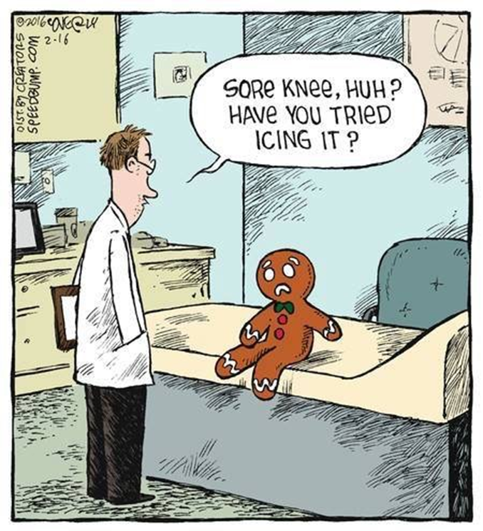
What conditions do chiropractors treat?

Slide 18
What conditions do chiropractors treat?
Spinal complaints
Radicular complaints
Shoulder complaints
Elbow complaints
Wrist/Hand complaints
Hip complaints
Knee complaints
Ankle/Foot/Toe complaints
Temporal Mandibular complaints

Slide 19
What is the cause of the patient’s back pain?

Slide 20
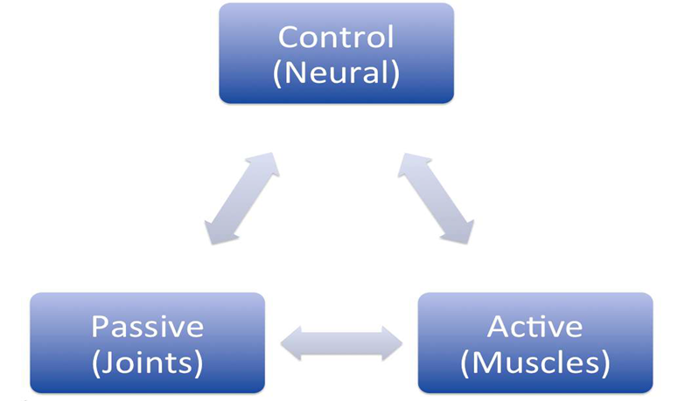
Musculoskeletal Complaints

Slide 21
Musculoskeletal Complaints

Slide 22
What makes a successful D.C./RHC relationship?
A. Having a great D.C.
B. Having a great MA (Medical Assistant)
C. Having a great Medical Director
D. Having a great clinic location

Slide 23
What are the characteristics of a D.C. that works best in a RHC?
A. The D.C. is great adjustor
B. The D.C. is a great communicator.
C. The D.C. understands his or her role and stays in his or her lane.
D. The D.C. plays well in the sand box and gets along well with others.

Slide 24
Established organizations utilizing DCs
Chiropractic is well-integrated in government sponsored healthcare programs and grants:
Medicare (part B) and Medicaid programs
Department of Defense military bases for active military personnel
Veteran’s Administration facilities
National Healthcare Service Corps
Community Health Clinics (FQHC, RHC, CHC)
National Institute of Health grants
Silicon Valley Hi Tech companies
NFL, NBA, MLB
Indian Health Services
Migrant Health Clinics

Slide 25
Role of a chiropractor in an FQHC or RHC
Chiropractors are listed as one of five types of physicians: MD, DO, DDS, DPM, DC (Federal Title 42)
Chiropractor's role in the Medicare system is to detect & correct for Vertebral Subluxations (Federal Title 42)
Chiropractors aid in the reduction of medications patients have to take.
Chiropractors perform non-duplicated pain management services.

Slide 26
Co-Management Provider Opportunities
Medical practitioners may rely on DCs to assist patients to reduce needs for opioids.
Dental practitioners may rely on DCs to assist in temporal-mandibular joint dysfunction (TMDs).
Behavioral health practitioners often see that as a result of chiropractic care, patients are sleeping better, coping better and are more successful in reducing overall medications.

Slide 27
Substance Abuse Mental Health Services Administration (SAMHSA) report: DCs can help

Slide 28
P. A. I. N.
P – Pain Anytime the provider is faced with only the choice of renewing a patient’s pain medication - especially after two or three prescriptions.
A – Accidents Sudden impact injuries from car accidents or serious falls will produce many obvious medical concerns. The DC will evaluate the patient for the more subtle injuries often overlooked because of the concern for the major injuries.
I – Injuries This refers to the more minor falls & injuries that did not cause a significant medical concern. The patient should be also checked by the DC to be sure to eliminate the possibility of small/minor problems that could become ongoing concerns if not caught.
N – Narcotic usage. Pain management that includes a chiropractic evaluation/treatment of some or many of the underlying causes of pain may significantly improve outcome, or, at least reduce the propensity to resort to higher dosages or more dangerous pharmacological options.

Slide 29
Chiropractic-an integrative health service
Chiropractic care focuses on non-communicable diseases that comprise 60% of morbidity burden.
Conventional thinking limits outcomes of chiropractic care to musculoskeletal conditions. But more than 100 years of clinical experience reveals greater overall health outcomes are due to primary and secondary neurological improvements.
When patients are suffering with complex medical histories, chiropractic care produces more than just the expected musculoskeletal results and makes an excellent addition to the FQHC/RHC team of providers.

Slide 30
J Altern Complement Med. 2018 Aug;24(8):792-800. doi: 10.1089/acm.2018.0218. Epub 2018 Jul 17.
Chiropractic Integration into Private Sector Medical Facilities: A Multisite Qualitative Case Study.
Lisi AJ1,2, Salsbury SA3, Twist EJ3, Goertz CM4
RESULTS:
These nine medical facilities had unique organizational structures and reasons for initiating chiropractic care in their settings. Across sites, DCs were sought to take an evidence-based approach to patient care, work collaboratively within a multidisciplinary team, engage in interprofessional case management, and adopt organizational mission and values. Chiropractic clinics were implemented within existing human resources, physical plant, information technology, and administrative support systems, and often expanded over time to address patient demand. DCs usually were co-located with medical providers and integrated into the collaborative management of patients with musculoskeletal and co-morbid conditions.

Slide 31
Anthony J. Lisi, DC,1,2 Stacie A. Salsbury, PhD, RN,3 Elissa J. Twist, DC, MS,3 and Christine M. Goertz, DC, PhD4 THE JOURNAL OF ALTERNATIVE AND COMPLEMENTARY MEDICINE 2018 Aug;24(8):792-800
Conclusions
We described the implementation of chiropractic services in a sample of nine U.S. private sector medical facilities.. Chiropractic service delivery was perceived to have high value among patients, medical providers, and administration, with most facilities expanding their chiropractic workforce to meet increased demand. Patient clinical outcomes, patient satisfaction, provider productivity, and cost offset were identified as markers of clinic success.

Slide 37
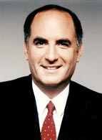
Richard L. Sarnat M.D. is a board certified physician, now specializing in Integrative medicine. He was a Phi Beta Kappa graduate of Washington University and was also nominated for Rhodes and Oxford scholarships. A graduate of Rush Medical College, he completed his residency at Northwestern University. He is the co-founder, President and Executive Medical Director of Alternative Medicine Integration Group, L.L.P., an outcomes-based medical management company promoting the integration of CAM modalities along with conventional medicine in a managed care setting.
Richard Sarnat, M.D

Slide 38
"...regular utilization of chiropractors as primary care physicians reduces the need for hospitalization by 60.2%, hospital days by 59%, pharmaceutical usage by 85%, outpatient surgeries and procedures by 62% and overall global health care costs by more than 50%.”
Richard Sarnat, M.D

Slide 39
May 20, 2019 | multimodal pain management Integrated Physician Medicine Reduces Visits for Neck, Back Pain
Research Cites Benefits of Employer-sponsored Health Clinics
Newswise — Employer-sponsored health clinics offering integrated physical medicine services—physical medicine, chiropractic, and acupuncture—can improve clinical outcomes while lowering the costs of care for patients with back pain and other common musculoskeletal conditions, reports an open-access paper in the May Journal of Occupational and Environmental Medicine.
Dena Bravata, MD, MS, of Stanford University and colleagues assessed the benefits of physical medicine services at 12 employer-sponsored health clinics. Among other innovative features, the clinics provided on-site access to physical therapists, chiropractors, and acupuncturists—integrated with primary care, behavioral health, and other services. The researchers analyzed clinical and economic outcomes of nearly 2,500 patients with musculoskeletal disorders seen at the clinics over 16 months.
Patients at the employer-sponsored clinics were able to access physical medicine services within about a week—much faster than a control group receiving traditional care in the community. Integrated physical medicine also led to greater improvements in physical functioning and fear of pain. These benefits were achieved with eight fewer clinic visits, leading to..

Slide 40
Typical chiropractic office includes: Chiropractor, 10x12 office, chiropractic table, desk & computer, and a medical (chiropractic) assistant

Slide 41
Questions?

