Slide 1
Staying Compliant in your RHC
July 27, 2022

Slide 2
Learning Objectives
Learn how to do a Mock Survey
Understand the Common Deficiencies
Apply the Appendix Z update

Slide 3
Secretary Becerra Extends PHE to July 2022

Slide 4
Overview of Mock Survey
Conduct your own mock survey with the staff using your checklist.
Hold a kickoff conference with staff and discuss how the mock survey will prepare them for the onsite visit.
Complete a walk through of the clinic with checklist in hand. Can you answer yes to all the questions? Are there areas of concern that need more attention?
Complete a policy review based on the policy section of the checklist. Do you have all the policies? Are they complete? If you are provider-based, are the policies specific to your clinic? (or have you clearly identified that you follow hospital policy?)
Interview staff to ensure they are knowledgeable about clinic policy, procedures and their individual job responsibilities. They should be comfortable answering any questions that the surveyor may ask.
Finish with a wrap up conference to discuss any areas of concern that need to be addressed prior to survey. Once you are confident you are ready for survey day, take time to celebrate your accomplishments!

Slide 5
Conducting a Self Survey – Time to Shine!
Everyone has worked hard to stay compliant and now is their time to shine!
Set the tone for the mock survey with a discussion to remind staff this is an “open book test” and there should be no surprises. If you can answer yes to each item on the checklist, your clinic is in compliance.
Enthusiasm not apprehension! Your surveyor will conduct a fair and unbiased survey. Staff should not be nervous but ready to show the surveyor what they do best.

Slide 6
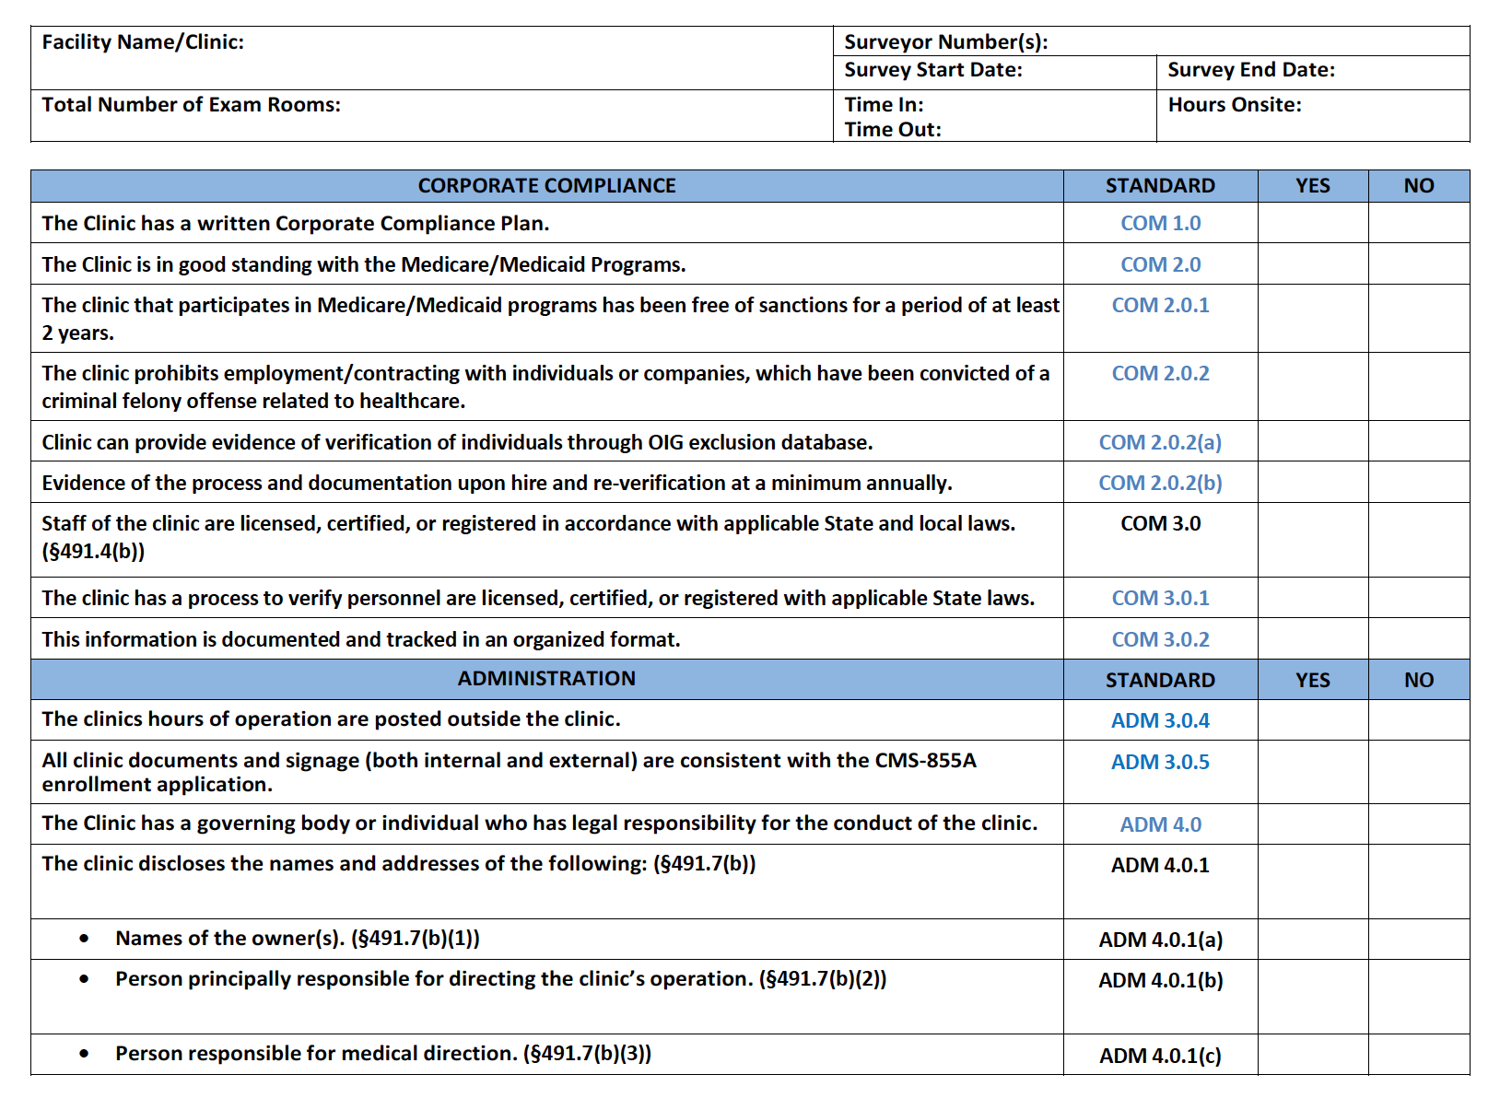
The RHC Checklist
The Compliance Team Quality Standards and Checklist incorporate the federal regulatory requirements with universal and specialty standards to demonstrate rural excellence through Exemplary Provider Accreditation

Slide 7
Mock Survey – Signage
Name on the sign is consistent with CMS 855A application

Slide 8
Changes to Clinic Name, location and Medical Director
Before moving: Check with State office of Rural Health and your MAC to be certain your new address is still in a HPSA, even if it’s next door.
Your location is grandfathered in at your present location.
Report name changes to CMS.
Report change in Medical Director to the State on a CMS29
Update your 855a and CMS 29 as things change.

Slide 9
The Entrance

Slide 10
The Entrance
Posted Hours of Operation

Slide 11
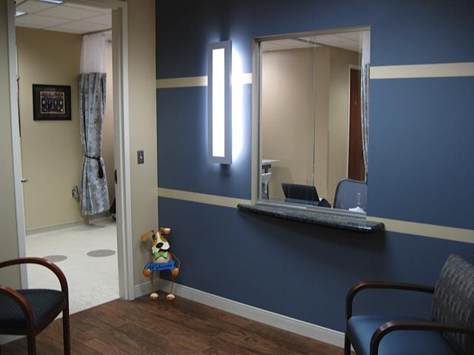
The Waiting Room

Slide 12
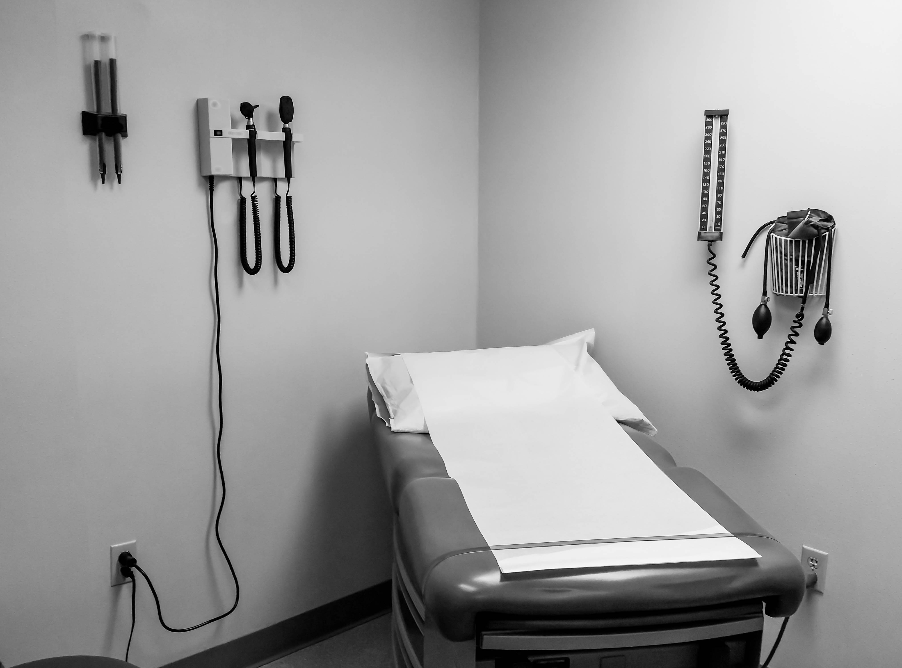
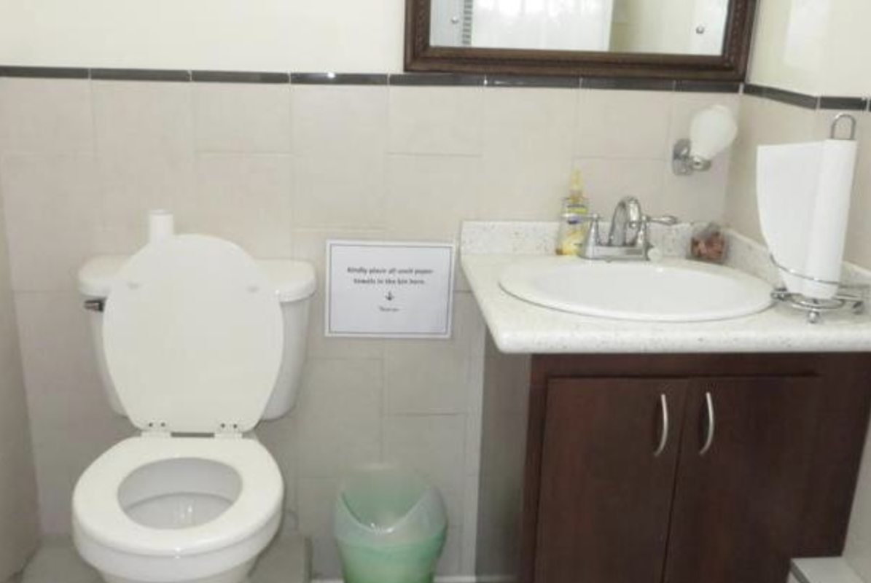
The Exam Rooms and Patient Bathroom

Slide 13
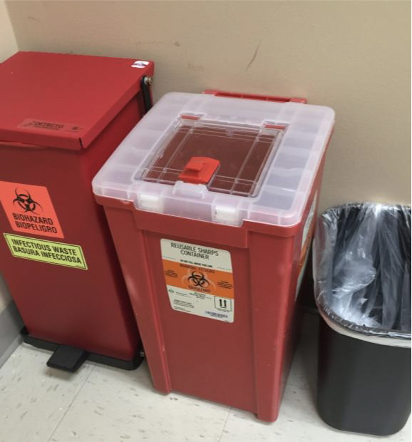
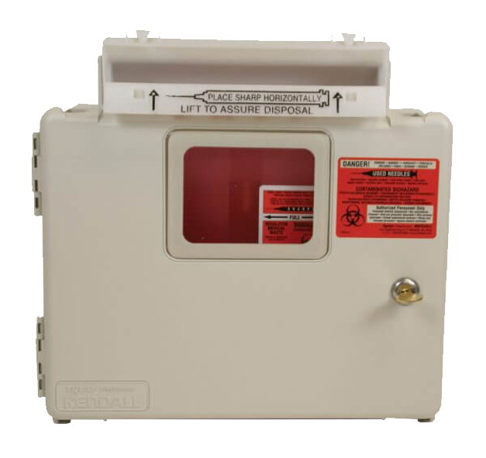
Biohazard Containers
Sharps containers cannot be easily accessible.
Several states require specific times on emptying of sharps containers.
Must be marked with a Bio-Hazard sticker

Slide 14
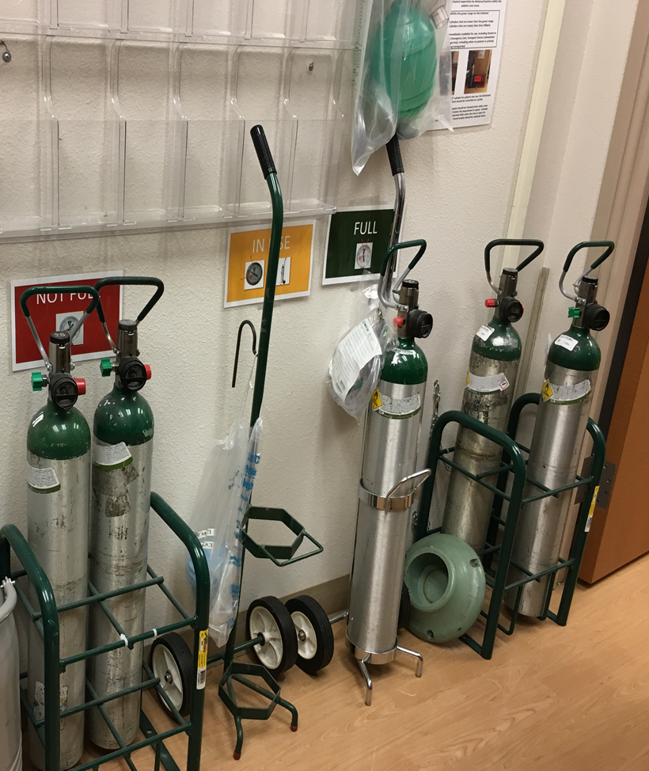
Mock Survey – Supply Storage and Oxygen
Safe storage of Oxygen:
Chained or in an approved cart.
Keep full separated from empty.

Slide 15
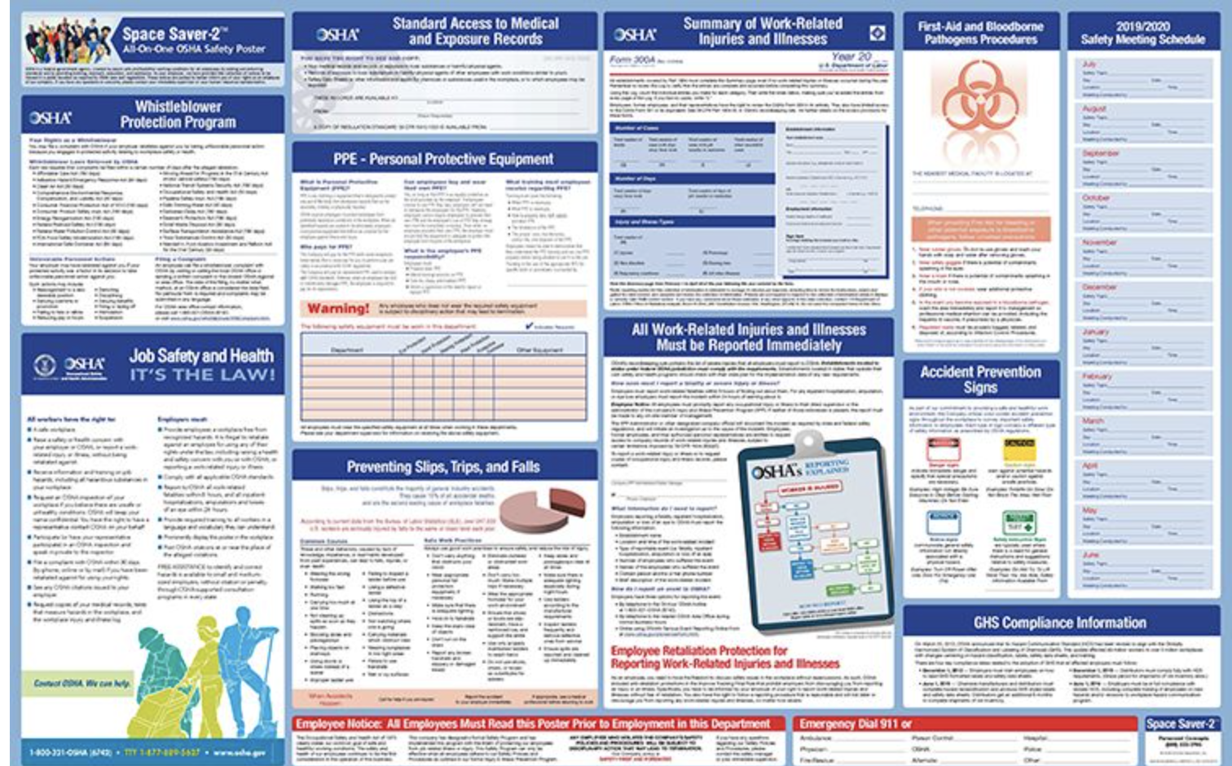
Mock Survey – Posters
Pre-order your 2023 posters!
State and Federal Posters are required to be in places visible to the staff.
Make sure you have the current year.
Provider based clinics must have these postings in the clinic even when the clinic in the hospital building

Slide 16
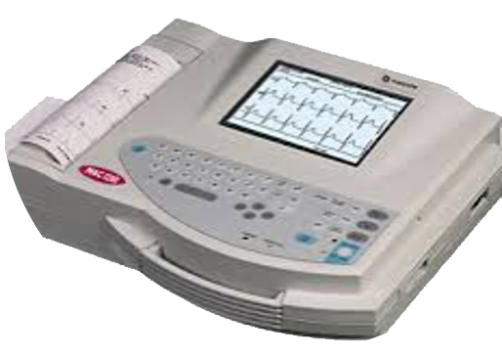
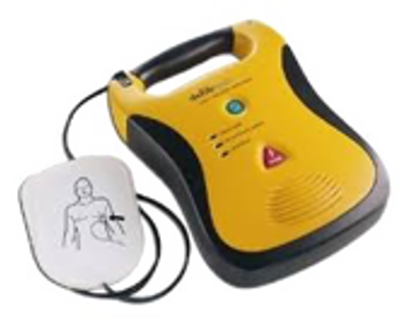
Mock Survey – Physical Plant: Equipment
All equipment resides on an Inventory List
Manufacturer’s IFUs determines need for Inspection vs Preventive Maintenance (PM)
Process in place for tracking due dates for PM
Evidence of initial inspection BEFORE use in patient care, unless you have a QC certificate.
Annual Bio-Med inspection is evident with stickers or report
Equipment not in use is labeled as such and stored away

Slide 17
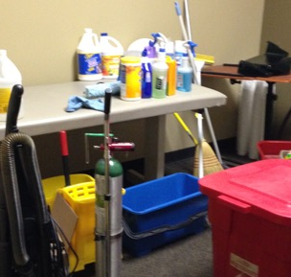
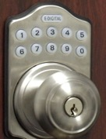
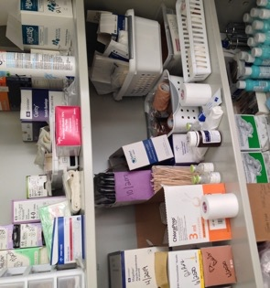
Mock Survey – What to Lock

Slide 18
HR File Elements
Application
I-9
W-4
OIG Exclusion
Signed Job Description
Standards of Conduct
Performance evaluations, according to your clinic schedule
Annual Training
Competency
Background checks as appropriate
TB screening on hire
Hep B for those who work with patients

Slide 19
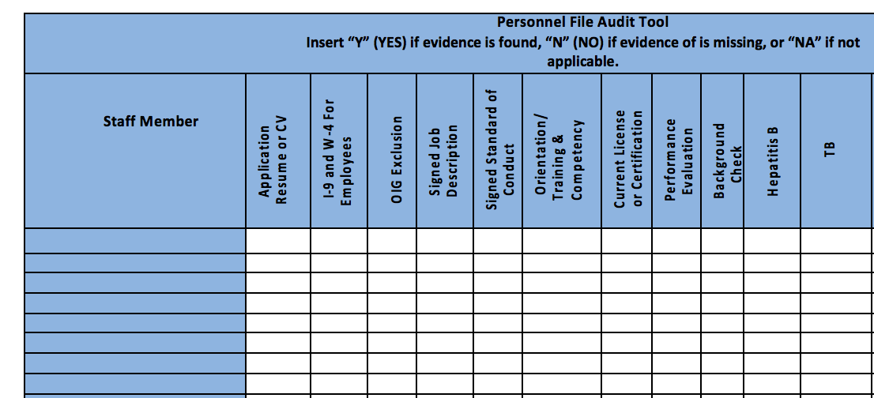
Mock Survey – HR Files
Are your HR Files complete and in order? Accessible for review?
Staff of the clinic or center are licensed, certified or registered in accordance with applicable State and local laws.

Slide 20
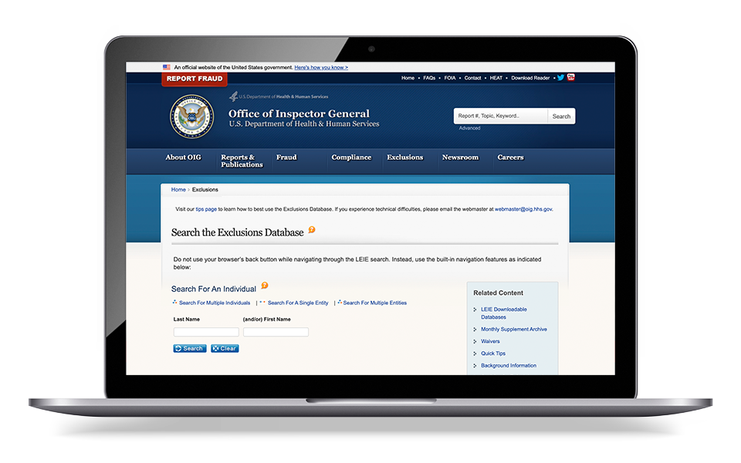
Mock Survey - HR File
OIG Exclusion list:
https://exclusions.oig.hhs.gov/

Slide 21
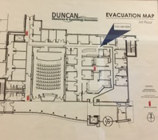
Mock Survey – Fire Safety
Fire Safety Process per State Regulations

Slide 22
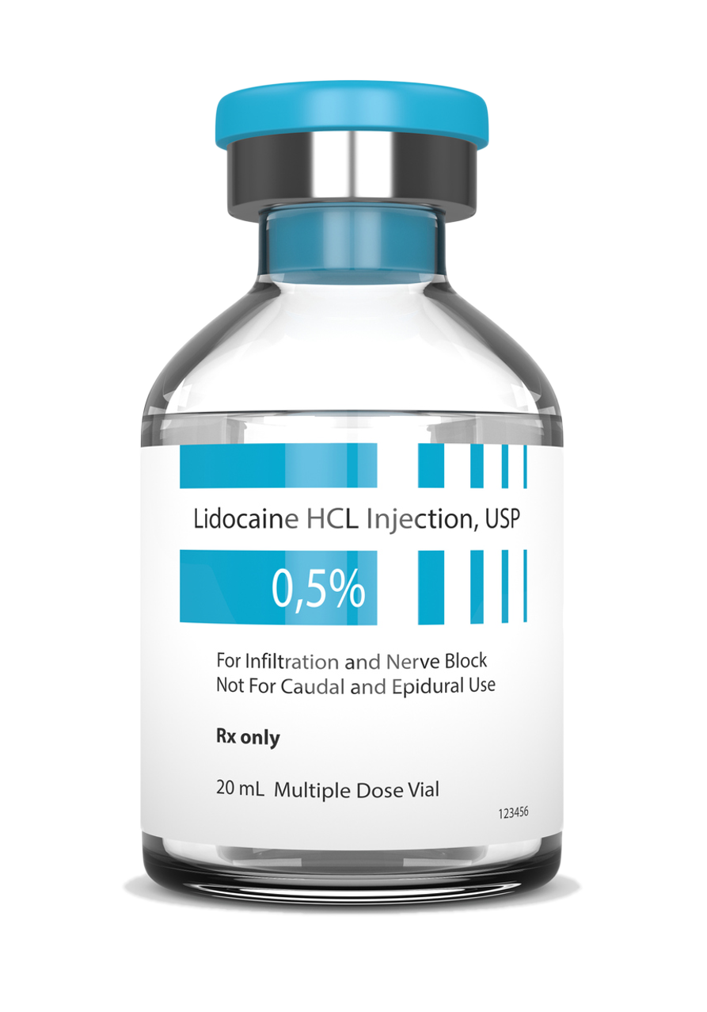
Mock Survey – Vials
Possibly a staff member does not know the difference between a single dose or multi-dose vial.
Possibly a certain drug always comes to you as an MDV but your supplier sent a shipment where the drug was an SDV.
Possibly we store MDVs and SDVs together making it easy to confuse.
What to do:
Train all staff to always look at the vial to verify if it’s an SDV or MDV and to check the date.
Train staff that SDVs do not have a preservative in the vial and why that’s important.
In the drug closet, separate the MDVs from the SDVs
Label all SDVs with a sticker
Single Dose Vials
Ensure Single-Dose Vials (SDVs) Are Never Used for More Than One Patient
Do Not Assume All Staff Know the Difference Between SDVs and MDVs.

Slide 23
Mock Survey - Vials
Multi Dose Vials
Single Dose Vials
28 Days

Slide 24
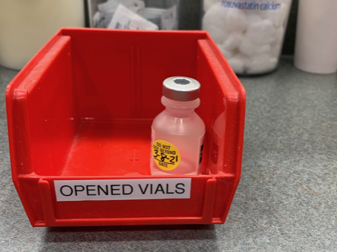
Mock Survey - Vials
Ensure Single-Dose Vials (SDVs) Are Never Used for More Than One Patient.
Once and done, discard!

Slide 25
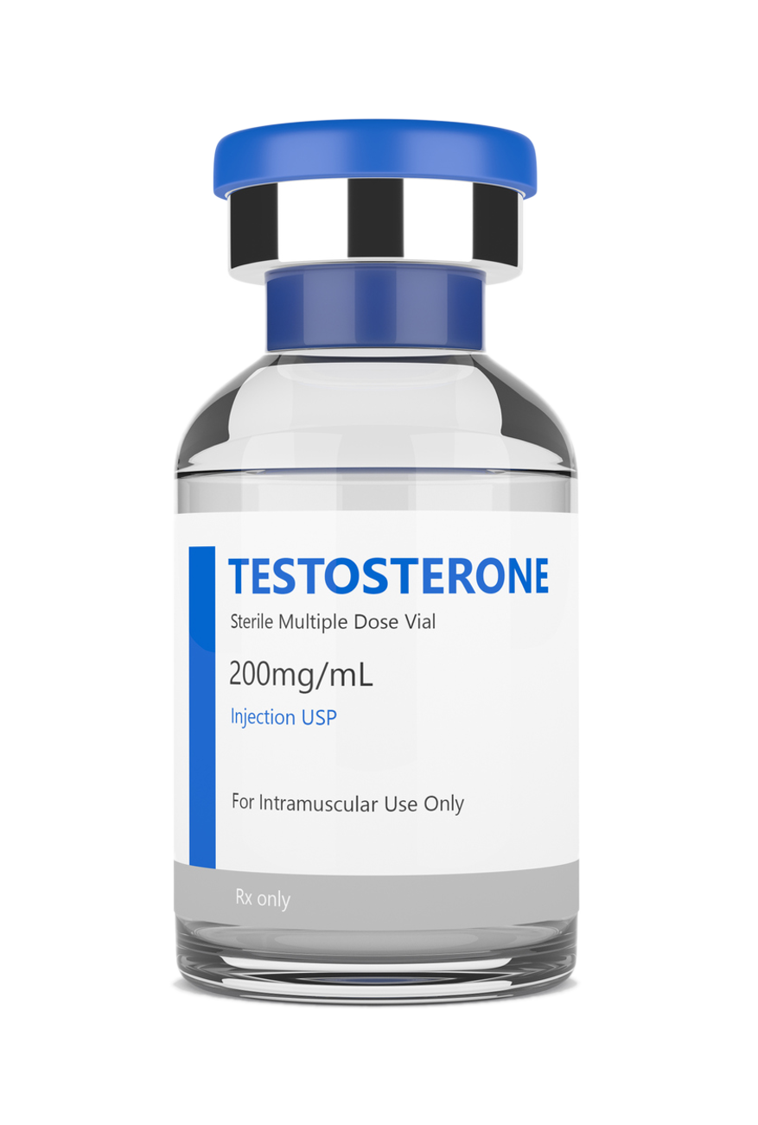
Mock Survey - Controlled Substances
Controlled Substances (CS) locked in a Substantial Cabinet.
Recordkeeping Logs for Ordering/ Dispensing.
MDVs, Storage in Sample Closet, Med Fridge, or Emergency Boxes must be secured.

Slide 26
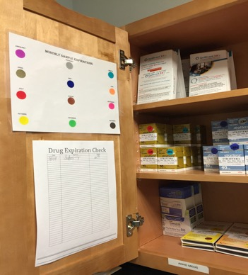
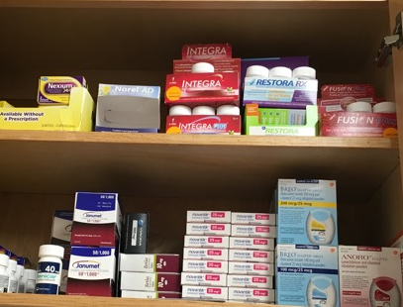
Mock Survey – Samples
Sample Medications secured and
logged to track in the event of a recall
Secured/Organized In Original Containers

Slide 27
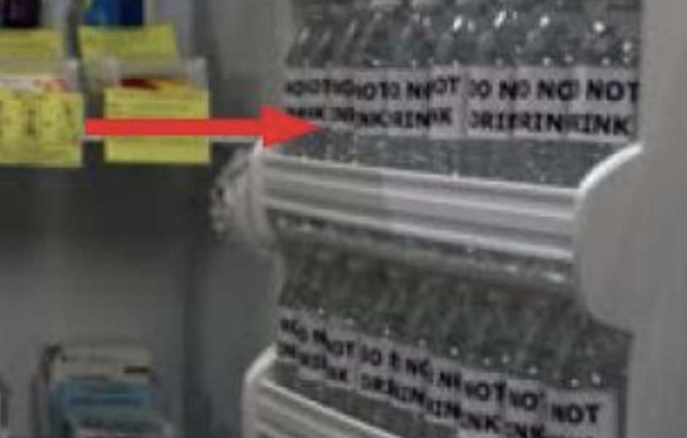
Mock Survey – Refrigerated Medications
No medications in the door of the refrigerator
Use water bottles to take up dead space
https://www.cdc.gov/vaccines/hcp/admin/storage/toolkit/storage-handling-toolkit.pdf

Slide 28
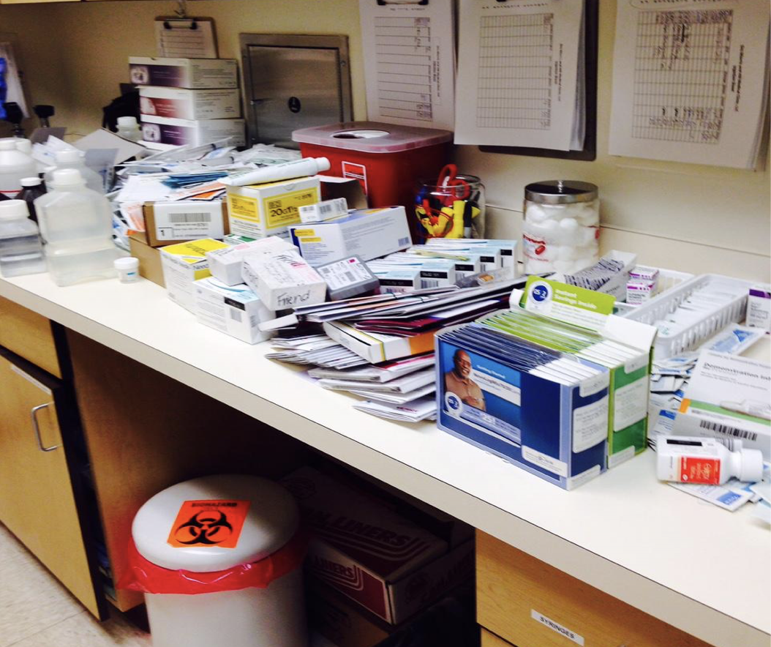
Mock Survey – Supplies
Telfa, gloves, peroxide, electrodes, needles
Iodoform gauze, etc.
Check anything with a date!
The red sharp container is not acceptable.

Slide 29
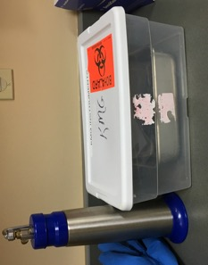
Instruments
Sterilizing instruments in the clinic.
- OR -
Accepting sterilized instruments from the hospital.

Slide 30
Mock Survey – Infection Prevention
Disposable Instrumentation is the easiest way to be compliant with recommended practices from nationally recognized organizations.
Once and done!

Slide 31
Mock Survey - Chart Review – 2 Types
Physician oversight If the State is silent, you choose a number and put it in your policy
Even when the NP has autonomy
Have a review log to prove the number of reviews matches your policy.
The log is signed by an MD or DO
Quality Improvement to feed into your Biennial Evaluation.
Maintain log and keep those charts for inclusion in your evaluation
Remember to add a closed record on occasion.

Slide 32
Mock Survey - Staff Responsibilities
Physician Assistant and Nurse Practitioner responsibilities:
Practices in accord with clinic policies
Participate with a physician in a periodic review of the patients' records.
Sign the policy binder review page at least every two years
Physician responsibilities:
In conjunction with the PA or NP participates in developing, executing, and periodically reviewing the clinic’s written policies and the services.
Periodically reviews the clinic’s patient records, provides medical orders, and provides medical care services to the patients of the clinic.
Sign the policy review page at least every two years and sign the patient review log.

Slide 33
Mock Survey – Staff Responsibilities
At least one PA or NP must be an employee of the clinic.
A Physician, NP, PA, certified nurse-midwife, clinical social worker, or clinical psychologist is available to furnish patient care services at all times the clinic operates.
This means no patient gets out of the waiting room unless there is a provider in the building.
In addition, for RHCs, an NP, PA, or certified nurse-midwife Is available to furnish patient care services at least 50 percent of the time the RHC operates.

Slide 34
Mock Survey - Patient Care Policies
The policies are developed with the advice of a group of professional personnel that includes one or more physicians and one or more PAs or NPs.
****At least one member is not a member of the clinic or center staff.

Slide 35
Mock Survey - Provision of Services
The clinic is primarily engaged in providing outpatient health services...
Means 51% RHC services
“The services of these practitioners are those commonly furnished in a physician’s office or at the entry point into the health care delivery system. These services include taking complete medical histories, performing complete physical examinations, assessments of health status, routine lab tests, diagnosis and treatment for common acute and chronic health problems and medical conditions, immunization programs and family planning.”
Appendix G

Slide 36
Mock Survey – Lab
6 Required tests in the Clinic:
Chemical examination of urine by stick or tablet method
Hemoglobin or Hematocrit
Blood Glucose
Examination of stool specimens for occult blood
Pregnancy Test
Primary Culturing for transmittal to a certified lab
Clinic follows all Manufacturer’s IFU for equipment and supplies.
Check for outdated supplies!!

Slide 37
Mock Survey - Lab
Clinic must have the ability to do all 6 required tests.
Most common one missing is Hemoglobin or Hematocrit for Provider Based clinics.
All reagents, strips, controls, etc., must be in date.
CLIA Certificate is current and posted.
CLIA has correct clinic name, address and lab director

Slide 38
Mock Survey - Patient care policies
The policies include:
A description of the services the clinic furnishes directly and those furnished through agreement or arrangement.
Guidelines for the medical management of health problems which include the conditions requiring medical consultation and/or patient referral
What reference do your non-physician providers use to research something?
Is it named in a policy?
The maintenance of health care records
Rules for the storage, handling, and administration of drugs and biologicals.
These policies are reviewed at least biennially by the group of professional personnel required. (Medical Director, NP/PA and outside person)

Slide 39
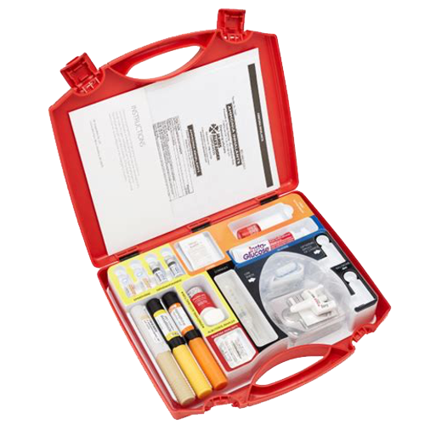
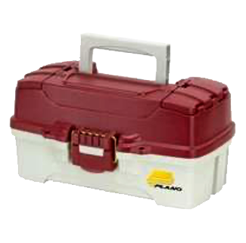
Mock Survey – Emergency Services
An RHC must have those drugs and biologicals that are necessary to provide its medical emergency procedures to common life-threatening injuries and acute illnesses.
The RHC should have written policies and procedures for determining what drugs/biologicals are stored to provide emergency services.
Policies and procedures should also reflect the process for determining which drugs/biologicals to store, including who is responsible for making the determination.
They should also be able to provide a complete list of which drugs/biologicals are stored and in what quantities.

Slide 40
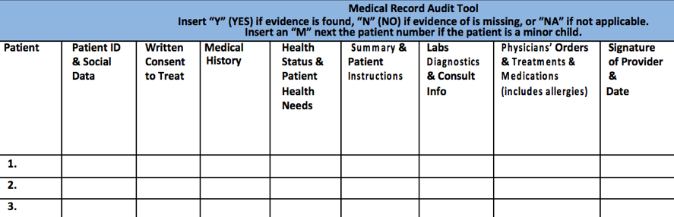
Mock Survey – Medical Record Review

Slide 41
Mock Survey - Biennial Evaluation
A review of your program every two years:
Must include review of:
Utilization of clinic services, including at least the number of patients served and the volume of services;
A representative sample of both active and closed clinical records; and
The clinic's health care policies.

Slide 42
Mock Survey - Biennial Evaluation
Why do this?
To determine whether:
Utilization of services was appropriate;
The established policies were followed; and
Any changes are needed.
The clinic considers the findings of the evaluation and takes corrective action if necessary.

Slide 43
Mock Survey – EP
Hazards assessment must be documented and a plan for each hazard identified.
Must include Emerging Infectious Disease (EID)
Communication plan is complete including name and contact information for all staff and local, regional, state and federal emergency staff.
Must address volunteers
Address how refrigerated medications are handled in a power outage.
Training: Have a log to document the staff trained, signed and dated. (every 2 years)

Slide 44
Mock Survey - Testing
Must participate in a full-scale exercise that is community-based or when not accessible, an individual, facility-based exercise.
If one year is full-scale exercise, then the other can be tabletop. Every other year for full-scale or at least a clinic-based exercise.
Analyze the clinic’s response to exercise or activation of plan.
Your exercise or tabletop must be one of your hazard assessments

Slide 45
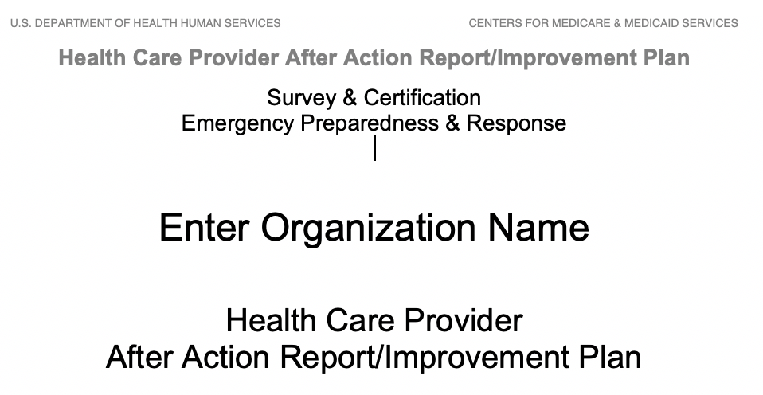
Emergency Preparedness Resources

Slide 46
AAR
This event in 2020/21 occurred as a result of a Corona Virus which resulted in a worldwide Pandemic.
The event began for ABC clinic on March __, 2020/21.
The emergency team was composed of _________ (names of staff in leadership)
Governor XXX declared a State emergency on March ?, 2020.
This report is the follow up analysis of the COVID-19 event which occurred in early 2020.
The purpose is to evaluate ABC clinic’s Emergency Preparedness program
Enter the top three strengths of your Emergency Plan
Examples: Staff training conducted on infection prevention
Plan to triage patients who come to the clinic
Plan to put sign on door to call from the car if symptomatic

Slide 47
AAR
Areas of Improvement
Need to order extra supplies such as masks and hand sanitizer earlier.
Need to minimize things in the waiting room to decrease things needing disinfecting.
Need for more screening of clinic staff, temps in the morning.
Need more separation of patients.
Event Successes
Staff immediately began calling patients instead of visit to decrease exposure for patients
Some staff sent to hospital to assist with surge
Older providers working from home doing Telehealth
Document staff meeting with date, time and training log with signatures.
Staff Training
Report reviewed with staff
Assignments given
Attendance log at AAR meeting

Slide 48
Appendix Z/Emergency Preparedness Update
New Guidance March 26, 2021. Effective 4.26.21
Your exercise must be one of your listed items on your HVA, unless it’s an event.
HVA must include EID (Emerging infectious Disease)
Facilities should ensure their EP programs are aligned with their State and local emergency plans/pandemic plans.
Testing survey procedures: Refer to the facility’s risk assessment to determine if the training and testing program is reflecting risks and hazards identified within the facility’s program.
This means you can’t use something as an exercise unless it’s on your hazard list.
Testing should also not test the same thing year after year or the same response processes. The intent is to identify gaps in the facility’s EP program as it relates to responding to various emergencies and ensure staff are knowledgeable on the facility’s program.
Volunteers: While not required to use volunteers as part of their plans to supplement or increase staffing during an emergency, the facility must have policies and procedures to address plans or emergency staffing needs.
Waivers: Policies and procedures in its emergency plan describing the facility’s role in providing care and treatment at alternate care sites under an 1135 waiver

Slide 49
Mock Survey – Staff Interviews
Can staff articulate procedures they are responsible for?
If asked, “What do you have to do to get fired here?” Do they know the answer?
If asked, “What do you do if you have to evacuate the clinic?” Do they know the protocol or have easy access to the emergency preparedness information for evacuation procedures?
Staff should be prepared to answer questions related to their job responsibilities, clinic policies and emergency protocols.

Slide 50
What to Expect on Survey Day
RHC surveys are unannounced so be prepared!
Managers share your knowledge with staff
Most surveys take between 6 to 9 hours per clinic depending on the size and number of providers/staff. If multiple clinics are being surveyed at the same time, the surveyor or survey team will inform you upon arrival of the number of days they expect to be onsite.
Remember that having easy access to policies, personnel records and medical records as they are requested will allow the surveyor to proceed without delay.
Once complete, the surveyor will conduct an exit interview to discuss the survey findings.

Slide 51
491.8(d) Vaccine Mandate Summary
The RHC/FQHC must develop and implement policies and procedures to ensure that all staff are fully vaccinated for COVID-19. For purposes of this section, staff are considered fully vaccinated if it has been 2 weeks or more since they completed a primary vaccination series for COVID-19. The completion of a primary vaccination series for COVID-19 is defined here as the administration of a single-dose vaccine, or the administration of all required doses of a multi-dose vaccine.
(1) Regardless of clinical responsibility or patient contact, the policies and procedures must apply to the following clinic or center staff, who provide any care, treatment, or other services for the clinic or center and/or its patients:
(i) RHC/FQHC employees;
(ii) Licensed practitioners;
(iii) Students, trainees, and volunteers; and
(iv) Individuals who provide care, treatment, or other services for the clinic or center and/or its patients, under contract or by other arrangement.

Slide 52
491.8(d) Vaccine Mandate Summary
(2) The policies and procedures of this section do not apply to the following clinic or center staff:
(i) Staff who exclusively provide telehealth or telemedicine services outside of the clinic or center setting and who do not have any direct contact with patients and other staff specified in paragraph (d)(1) of this section; and
(ii) Staff who provide support services for the clinic or center that are performed exclusively outside of the clinic or center setting and who do not have any direct contact with patients and other staff specified in paragraph (d)(1) of this section.
.

Slide 53
491.8(d) Vaccine Mandate Summary
(3) The policies and procedures must include, at a minimum, the following components:
(i) A process for ensuring all staff specified in paragraph (d)(1) of this section (except for those staff who have pending requests for, or who have been granted, exemptions to the vaccination requirements of this section, or those staff for whom COVID-19 vaccination must be temporarily delayed, as recommended by the CDC, due to clinical precautions and considerations) have received, at a minimum,
A single-dose COVID-19 vaccine, or the first dose of the primary vaccination series for a multi-dose COVID-19 vaccine prior to staff providing any care, treatment, or other services for the clinic or center and/or its patients;
(ii) A process for ensuring that all staff specified in paragraph (d)(1) of this section are fully vaccinated for COVID-19, except for those staff who have been granted exemptions to the vaccination requirements of this section, or those staff for whom COVID-19 vaccination must be temporarily delayed, as recommended by the CDC, due to clinical precautions and considerations;

Slide 54
491.8(d) Vaccine Mandate Summary
iii) A process for ensuring that the clinic or center follows nationally recognized infection prevention and control guidelines intended to mitigate the transmission and spread of COVID-19, and which must include the implementation of additional precautions for all staff who are not fully vaccinated for COVID-19;
(iv) A process for tracking and securely documenting the COVID-19 vaccination status for all staff specified in paragraph (d)(1) of this section;
(v) A process for tracking and securely documenting the COVID-19 vaccination status of any staff who have obtained any booster doses as recommended by the CDC;
(vi) A process by which staff may request an exemption from the staff COVID-19 vaccination requirements based on an applicable Federal law;
(vii) A process for tracking and securely documenting information provided by those staff who have requested, and for whom the facility has granted, an exemption from the staff COVID-19 vaccination requirements;

Slide 55
491.8(d) Vaccine Mandate Summary
(viii) A process for ensuring that all documentation, which confirms recognized clinical contraindications to COVID-19 vaccines and which supports staff requests for medical exemptions from vaccination, has been signed and dated by a licensed practitioner, who is not the individual requesting the exemption, and who is acting within their respective scope of practice as defined by, and in accordance with, all applicable State and local laws, and for further ensuring that such documentation contains:
A) All information specifying which of the authorized COVID-19 vaccines are clinically contraindicated for the staff member to receive and the recognized clinical reasons for the contraindications; and
(B) A statement by the authenticating practitioner recommending that the staff member be exempted from the clinic or center’s COVID-19 vaccination requirements for staff based on the recognized clinical contraindications;

Slide 56
491.8(d) Vaccine Mandate Summary
(ix) A process for ensuring the tracking and secure documentation of the vaccination status of staff for whom COVID-19 vaccination must be temporarily delayed, as recommended by the CDC, due to clinical precautions and considerations, including, but not limited to, individuals with acute illness secondary to COVID-19, and individuals who received monoclonal antibodies or convalescent plasma for COVID-19 treatment; and
(x) Contingency plans for staff who are not fully vaccinated for COVID-19.
Detailed information about exemptions is found here: https://www.eeoc.gov/wysk/what-you-should-know-about-covid-19-and-ada-rehabilitation-act-and-other-eeo-laws

Slide 57
QUESTIONS?
Cheryl Duncan, Accreditation Advisor
215-654-9110
cduncan@thecomplianceteam.org

