Slide 2
Agenda
RHC Modernization – Medicare Payment Reform
Regulatory Updates
Mental Health via Telehealth
Hospice; Vaccine Administration
Vaccine Mandate
2023 Medicare Physician Fee Schedule - NEW
Legislative Updates
Telehealth Policy Post PHE
Behavioral Health – President’s Budget
Federal COVID-19 Funding for RHCs
No Surprises Act – Good Faith Estimate

Slide 3
RHC Modernization – Medicare Payment Reform

Slide 4
The What
H.R. 133 (Consolidated Appropriations Act of 2021) → drastic Medicare RHC payment methodology reform
All RHCs are subject to a cap
Grandfathered/previously uncapped RHCs – clinic specific upper payment limits (based on 2020 reimbursement rates) that will increase each year per Medicare Economic Index (MEI)
All new (855A submitted after 12/31/2020) and previously independent RHCs – Medicare upper payment limit ($113 in 2022)

Slide 5
RHC Reimbursement (National Statutory Cap)
On April 1, 2021 the RHC upper payment limit increased from $87.52 to $100. The cap then increases each year as follows:
2022 $113.00
2023 $126.00
2024 $139.00
2025 $152.00
2026 $165.00
2027 $178.00
2028 $190.00
After 2028, the cap will increase according to the Medicare Economic Index (MEI)

Slide 6
The Why
Negative attention paid to the RHC program because of:
HIGH uncapped rates
RHC closures (primarily independents that couldn’t survive on $87 per visit)
President Trump’s budget included a proposal to cap all RHCs at a nationwide cap
Projected to save money but would negatively impact RHCs

Slide 7
NARHC’s Policy Objectives
Slow the loss/closure of RHCs driven by unrealistically low caps
Narrow the gaps between “uncapped” and “capped” RHCs
Without reducing payments to existing RHCs!

Slide 8
Total Number of RHCs 2016-2022
Calendar Year | Total
2022 | 5,206 (July 2022)
2021 | 5,095
2020 | 4,870
2019 | 4,630
2018 | 4,503
2017 | 4,364
2016 | 4,299

Slide 9
Comparison Capped/Grandfathered Payments - New Law

Slide 10
The Now
2022 Medicare Physician Fee Schedule finalized these payment changes
Determined that Changes in Ownership (when the CCN is retained) and changes of address (so long as RHC location requirements are met) will not result in a loss of grandfathering status
2023 Medicare Physician Fee Schedule proposed that MACs should use the cost report ending in 2020 (or 2021 if applicable) that reports costs for 12-consecutive months in determining clinic-specific upper payment limits (grandfathered rate)

Slide 11
For more detailed information, go to:
Rural Health Clinic Modernization Policy Explained :
https://www.narhc.org/News/28696/Rural-Health-Clinic-Modernization-Included-in-Final-COVID-Package
www.NARHC.org

Slide 12
Quality Reporting / Value Based Care
Health care is moving towards value based care
Traditional Medicare has no quality reporting requirement
NARHC is engaged on both the regulatory and legislative sides regarding a quality reporting program that would align with the RHC payment methodology
Ex. Bonus payment or AIR bump (1-3%?) for quality
Proposed legislation restores uncapped status for previously uncapped RHCs, in exchange for quality reporting
NARHC’s Position: Supportive of quality reporting being an option for RHCs, if offered to ALL RHCs, regardless of ownership

Slide 13
Regulatory Updates – 2022 Physician Fee Schedule

Slide 14
Mental Health via Telehealth
In December of 2020, Congress made permanent Medicare coverage of telehealth for mental health services but made no mention of how this might extend to safety net providers.
CMS finalized a regulatory change to the definition of an RHC (and FQHC) mental health encounter to include telehealth encounters:
(3) Visit - Mental health. A mental health visit is a face-to-face encounter or an encounter furnished using interactive, real-time, audio and video telecommunications technology or audio-only interactions in cases where the patient is not capable of, or does not consent to, the use of video technology for the purposes of diagnosis, evaluation or treatment of a mental health disorder between an RHC or FQHC patient and one of the following…
NARHC welcomed this policy change by CMS allowing RHCs to use normal coding, normal reimbursement, and normal cost reporting rules for mental health telehealth visits.

Slide 15
Mental Health via Telehealth In-Person Requirements
In-person requirements are waived during PHE and for 151 days after PHE ends
After this period, beneficiaries must have an in-person visit within 6 months of furnishing mental health via telehealth service and an in-person service must be provided at least every 12 months thereafter.
Some exceptions may be made based on patient need
Some of the details are unclear –
Does the telehealth provider need to be the provider that sees the patient for their in-person visit?

Slide 16
Public Health Emergency Update
Health and Human Services (HHS) Secretary Becerra renewed the PHE on July 15, 2022.
Renewals can be for UP TO 90 days at a time
States will receive minimum 60 days notice when the PHE is set to expire / not be renewed

Slide 17
Other 2022 PFS RHC Provisions Beginning January 1, 2022
Hospice: RHC clinicians can provide hospice related care to a Medicare beneficiary enrolled in hospice and receive the all-inclusive rate payment for attending physician services.
Vaccine Administration: RHCs should bill Medicare Advantage directly for COVID-19 vaccine administration.
CCM/TCM: RHCs can bill for Transitional Care Management (TCM) and other care management services like CCM provided to the same beneficiary in the same time period, so long as all billing requirements for each code are followed.

Slide 18
2023 Medicare Physician Fee Schedule
Proposed rule released July 7th
Comments due September 7th
Final rule expected mid-November
Policies, if finalized, in effect January 1, 2023

Slide 19
2023 MPFS Relevant Provisions
RHC Payment Methodology
CMS proposes that MACs use the cost report ending in 2020 (or 2021 for RHCs that don’t have an AIR established for 2020 services furnished) that reports costs for 12 consecutive months

Slide 20
2023 MPFS Relevant Provisions
New Care Management Codes Billable in RHCs
Chronic Pain Management (CPM)
General Behavioral Health Integration (GBHI)
Billed under G0511 which is currently a consolidated fee schedule rate of 6 codes ($79.25 in 2022)
The addition of these codes will not change the average used to calculate the G0511 rate but it will continue to be updated annually

Slide 21
2023 MPFS Relevant Provisions
Medicare Economic Index (MEI) Rebasing
Proposal to use new methodology to calculate MEI using 2017 publicly available data sources instead of 2006-based inputs
NARHC is appreciative of the efforts to acknowledge issues with the outdated formula but 2017 data remains behind the impacts of current inflation

Slide 22
Regulatory Updates – COVID-19 Vaccine Mandate

Slide 23
CMS COVID-19 Vaccine Mandate
The Supreme Court upheld the mandate in all 50 states.
RHCs must incorporate vaccine mandate policy and procedure per 42 CFR 491.8(d) and be acting in accordance with your P&P.
NARHC has created a sample P&P which can be found here.
All RHC staff must be fully vaccinated or granted a medical or religious exemption.
Mandate in effect for indefinite future (not tied to the PHE)

Slide 24
Regulatory Updates – Medicare Sequester

Slide 25
2% Medicare Sequester Back in Effect
Beginning July 1, 2022 Medicare sequester policy was fully re-implemented
RHCs, and all of healthcare, should now expect to receive 78.4% of allowable costs
A similar, 4% “pay as you go” or “PAYGO” Medicare reduction is currently scheduled to kick in on January 1, 2023
There is industry wide expectation that Congress will again waive this payment reduction
The use of the sequester has long since been part of the games of political/budget chicken with significant impacts on things like Medicare reimbursement! For a more in-depth history, visit NARHC.org.

Slide 26
Legislative Updates – Telehealth Policy Post-PHE

Slide 27
Current Medicare Telehealth Billing Policies
Name of Telehealth Service | Brief Description | How to Bill | Amount (2022)
Virtual Check-In or Virtual Care Communications | Remote evaluation – G2010 Brief communication with patient (5 min) – G2012 | G0071 No modifier necessary Rev Code 052X | $23.88
Chronic Care Management | 99484, 99487, 99490, 99491, 99424, and 99425 = G0511 99492, 99493 = G0512 | G0511 – Care Management G0512 – Psychiatric Care Management | G0511 - $79.25 G0512 - $151.23
Digital e-visits | Online digital evaluation and management 99421-99423 | G0071 No modifier Rev Code 052X | $23.88
Telehealth Visits | One to one substitutes for in-person services/visits List of allowable services maintained by CMS | G2025 Modifier 95 optional Modifier CS (for services where cost sharing is waived) Rev Code 052X Costs and encounters carved out of cost report | $97.24
Mental Health Telehealth Visits | CPT Codes that can be billed with 0900 revenue code | Rev Code 0900 Use proper mental health CPT code Modifier CG always Modifier 95 if audio-video Modifier FQ if audio-only Count costs and encounters on cost report | All-Inclusive Rate
These codes are not new but fall within the telehealth umbrella!
Notes:
The bolded CCM codes are the codes used to crosswalk the values of the NEW codes that the 2023 PFS makes billable under CCM which is why the average is not being re-calculated.

Slide 28
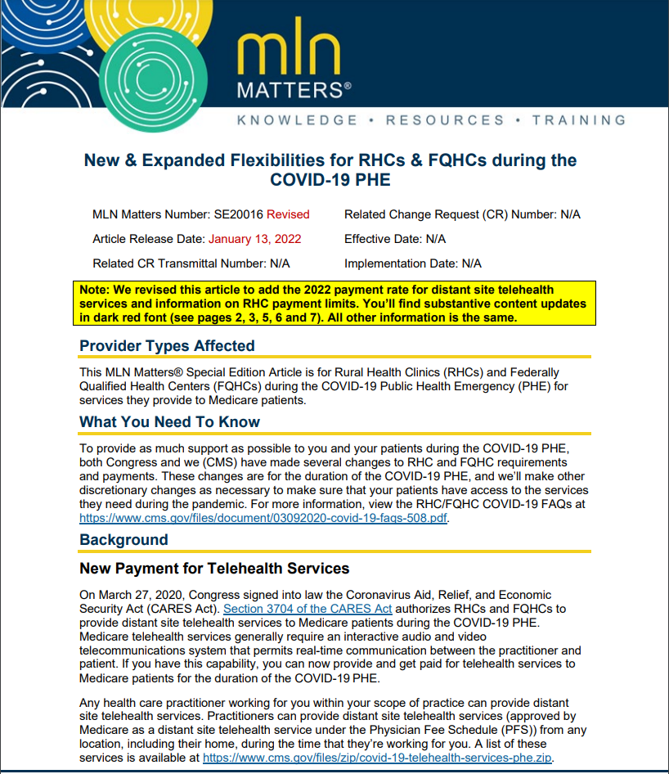
G2025 Policy Established – April 17, 2020
MLN Matters SE 20016
Special Payment Rule from the CARES Act is interpreted by CMS to be one payment rate and code for all telehealth services
RHCs to bill G2025 for any of 200+ CPT codes that FFS providers can bill as a telehealth visit listed here
Costs and encounters associated with telehealth visits must be carved out of the cost report

Slide 29
Concerns with G2025 System
Payment of $97.24 is less than AIR for vast majority of RHCs
May disincentive RHCs from providing telehealth as a replacement for in-person encounters
Carve-out process presents administrative challenges
Disguises the actual service provided causing a number of downstream problems such as:
Hard (Impossible?) to identify AWV done via telehealth
G2025 is not eligible for risk adjustment for ACOs or Medicare Advantage
Without descriptions of the services provided, there are challenges in gathering good data

Slide 30
March 11th “Omnibus” bill
De-links Medicare telehealth waivers from PHE
Telehealth waivers (coverage) extended for 151 days (5-months) post PHE
Mental health via telehealth is permanently covered; in-person requirements waived for PHE + 151 days

Slide 31
What does Medicare telehealth coverage look like in the future?
It is evident that telehealth is here to stay, but the details remain undecided
What telehealth waivers will be rescinded, modified, and kept?
Ex. Will HIPAA compliant platforms be required again?
Ex. Will providers need to be in specified distant site locations?
Ex. Will Medicare pay parity with in-person visits?
Ex. Will audio-only telehealth be allowed? What services can be done audio-only?
Ex. Will there be in-person requirements for all telehealth?

Slide 32
MedPAC Study Due June 2023
Consolidated Appropriations Act of 2022 (March 11th bill) directed MedPAC to analyze telehealth policy
The legislation mandates that the study analyzes:
“The utilization of telehealth services under the Medicare program…
Medicare program expenditures…
Medicare payment policy for telehealth services and alternative approaches to such payment policy, including for federally qualified health centers and rural health clinics.”
There is speculation that Congress will extend telehealth waivers until they get more information, particularly from this study

Slide 33
The Big Questions
Does telehealth save Medicare money or does telehealth cost Medicare money?
Does a telehealth visit replace an in-person visit or does it increase volume?
The MedPAC study and others will provide data to begin answering these questions, but ultimately the analysis from the Congressional Budget Office (CBO) will have the greatest impact…

Slide 34
Moving Forward
Likely to be a series of temporary extensions of Medicare telehealth policy as questions are answered
Each extension provides Congress with an opportunity to tweak aspects of the telehealth policy
There is bipartisan agreement and industry wide expectations that Medicare telehealth policy will not revert to the very limited pre-COVID rules.

Slide 35
Behavioral Health Provisions in President Biden’s Proposed Budget

Slide 36
RHC Provisions – March 2020
RHC Behavioral Health Initiative
$10 million for a RHC grant program – funding RHCs where there is no behavioral health provider (“fund the salary of a behavioral health provider, address provider burnout, and expand the availability of services such as mental health screenings, counseling, and therapy.”)
Modernize Medicare Mental Health Benefits
Allow payment to RHCs/FQHCs for Licensed Professional Counselors and Marriage and Family Therapists providing mental health services

Slide 37
RHC Behavioral Health Initiative Update
Outreach to Committees of Jurisdiction
Letters to House HHS/Labor Appropriations Subcommittee, House Ways & Means, House Energy and Commerce, Senate Committee on Finance
Joint meetings with NRHA and NOSORH
House Appropriations Report Included $5 million for RHC BHI (!!)
First, but very important step in establishing a grant program for RHCs
Next steps: Senate report language and final appropriations package

Slide 38
Federal COVID-19 Funding and Supply Programs for RHCs

Slide 39
Funding Program | Date | Amount | Purpose | Reporting
Phase 1 General Distribution | April 10, 2020 | 6.2% of 2019 Medicare Reimbursement | Lost Revenue and Unreimbursed COVID Expenses | Provider Relief Fund Portal
Phase 2 General Distribution | April 24, 2020 | 2% of 2018 revenue minus phase 1 distribution | Lost Revenue and Unreimbursed COVID Expenses | Provider Relief Fund Portal
Phase 3 General Distribution | December 15, 2020 | Variable | Lost Revenue and Unreimbursed COVID Expenses | Provider Relief Fund Portal
Rural Targeted Allocation | May 6, 2020 | $103k + 3.6% operating expenses (Ind), Graduated Base Payment + 1.97% of operating expenses (PB) | Lost Revenue and Unreimbursed COVID Expenses | Provider Relief Fund Portal
RHC COVID-19 Testing Fund | May 20, 2020 + later dates | $49,461.42 per RHC | Unreimbursed COVID testing expenses | www.RHCcovidreporting.com
RHC COVID-19 Testing and Mitigation Fund | June 10, 2021 + later dates | $100,000 per RHC | Unreimbursed COVID testing and mitigation expenses | www.RHCcovidreporting.com
RHC Vaccine Confidence Grants | July 22, 2021 | Approximately $49,529.00 | Vaccine hesitancy work | Financial Reports through Payment Management System + Quarterly Calls
American Rescue Plan + Phase 4 General Distribution | November/December 2021 | Variable | Lost Revenue and Unreimbursed COVID Expenses | Provider Relief Fund Portal

Slide 40
RHC COVID-19 Funding Program Reminders
RHC COVID-19 Testing and Mitigation (RHCCTM)
$100,000 per RHC
Automatically awarded beginning June 2021 to reporting compliant RHCs
Project Period: January 1, 2021 – December 31, 2022
Reporting on RHCcovidreporting.com through Jan. 2023
Allowable Expenses
Testing and testing-related
Mitigation and mitigation-related
Otherwise unreimbursed
Retention payments!
Expanding digital technologies!
Facility retrofitting!

Slide 41
RHC COVID-19 Vaccine Confidence Grants
~$49,529 per awarded RHC in July/August 2021 for vaccine confidence efforts
Project Period: July 1, 2021 – June 30, 2022 (unless your RHC was granted a no-cost extension)
Funds drawn down on Payment Management System (PMS) and managed on HRSA Electronic Handbooks (EHB)
Last day to draw down funds and complete closeout requirements is September 28, 2022!

Slide 42
HRSA COVID-19 Testing Supply and Therapeutics Program
Free, direct supply of:
At-home test kits
Point-of-care testing supplies
Enrollment available here!
The newest HRSA program offers free, direct access to COVID therapeutics, allowing RHCs to participate in the nationwide “Test-to-Treat” program
Visit narhc.org for enrollment steps and to learn more!

Slide 43
No Surprises Act / Good Faith Estimate

Slide 44
No Surprises Act – Good Faith Estimate
The section of the No Surprises Act that DOES apply to RHCs is related to price transparency.
Beginning Jan. 1, 2022, ALL RHCs must provide a Good Faith Estimate (GFE) of reasonably expected charges for items and services to an uninsured (or self-pay) individual that either:
Requests the GFE, OR
Schedules an appointment 3+ days in advance

Slide 45
NARHC / CMS Resources
Webinar and Q&A Follow-Up
https://vimeo.com/657020221/8ed2ca0928
https://www.narhc.org/Document.asp?DocID=11051
Required GFE notices to be posted in your clinics and sample GFEs can be found here.
CMS FAQs
Part 1
Part 2
NARHC continues to work with CMS to obtain additional guidance and advocate for more reasonable and less burdensome price transparency measures that achieve the initial, positive intent.

Slide 46
Stay “In the Know” on RHC Issues
NARHC.org
Email Listserv
Discussion Forum
News Tab
Resources Tab
TA Webinars
Advocacy Letters and Comments

Slide 47
Questions? Sarah Hohman, MPH Director of Government Affairs National Association of Rural Health Clinics 202-543-0348 Sarah.Hohman@narhc.org

