Slide 1
Complex Care Management Program
Raul Ayala, MD, MHCM
Ambulatory Medical Officer
Designated Institutional Official (DIO)

Slide 2
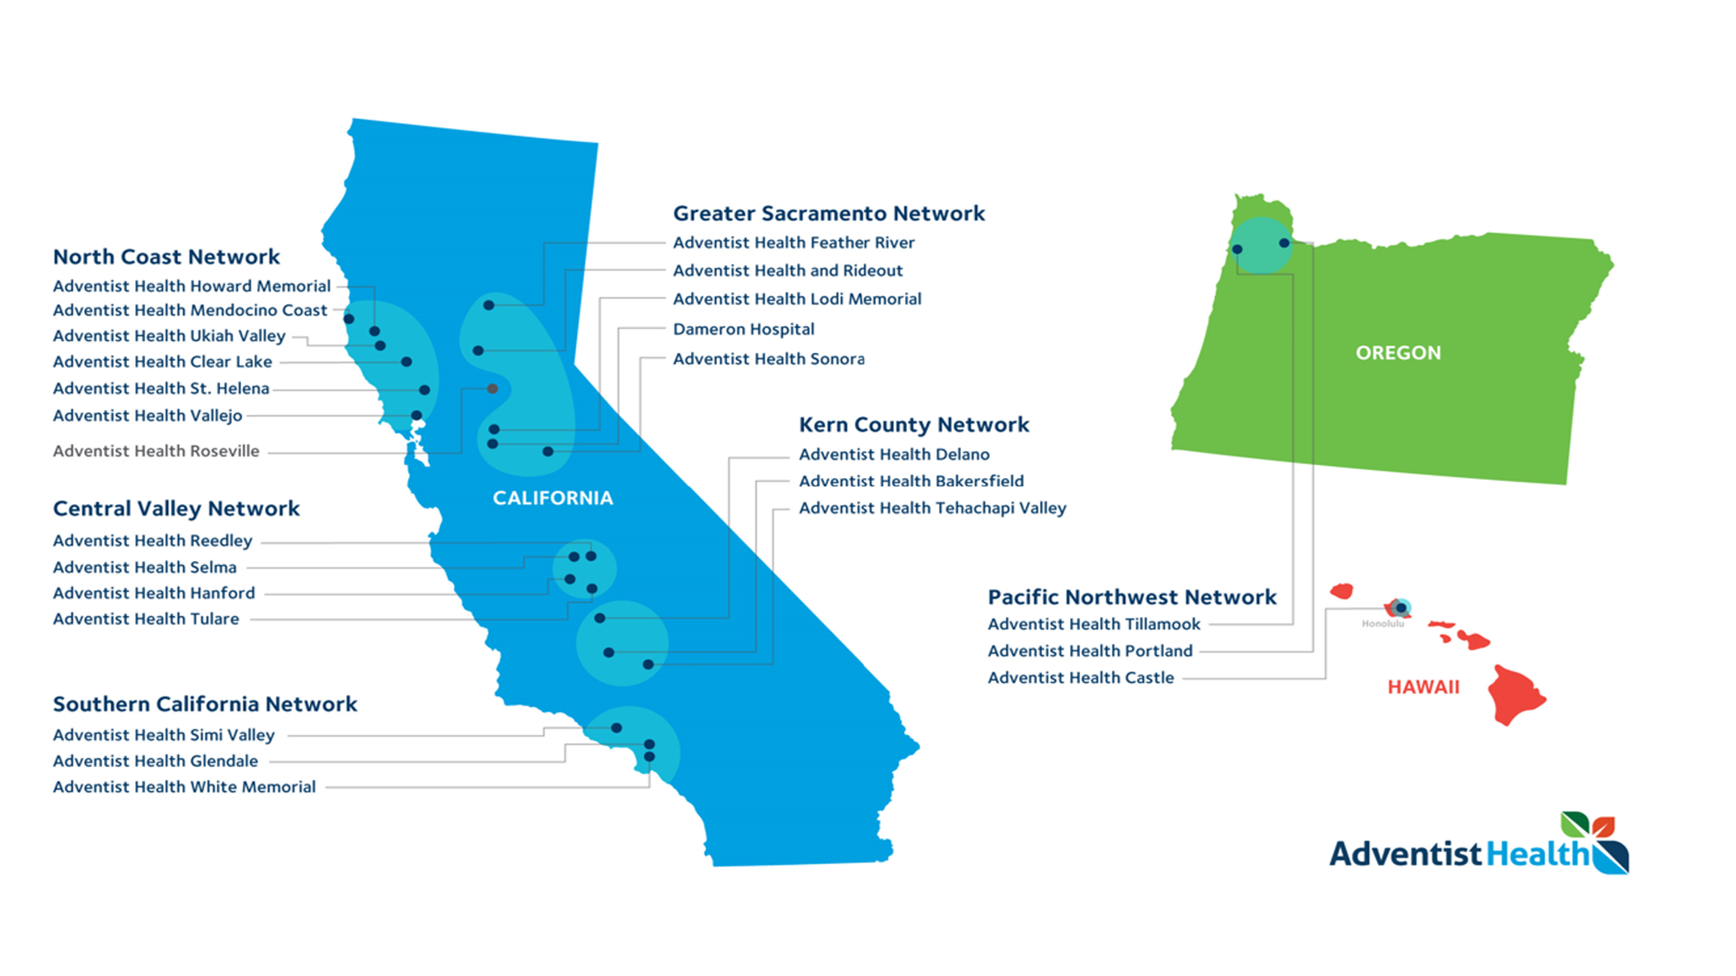

Slide 4
Patient 34 y/o M with PMH of Diabetes, ESRD on dialysis, Hypertension, Schizophrenia with recent Methamphetamine abuse.

Slide 5
Patient 79 y/o F living at home with Dementia, Hypertension, Diabetes, Hyperlipidemia, advanced arthritis who is cared for by her husband who is 76 y/o with PMH of Advanced Diabetes, Hypertension, a recent Amputee and uses a walker.

Slide 6
Patient 22 y/o F with Cerebral Palsy who is on a trach with ventilator, advanced pulmonary disease with multiple readmissions for UTIs.

Slide 7
How did we get started?

Slide 8
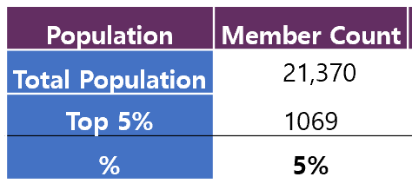
Top 5% Adventist Health Plan
The top 1% accounted for 53% of total spend
The top 5% accounted for 80% of the total spend
The top 5 chronic conditions are:
Hypertension
Mental Health Non-Serious Mental Illness
Chronic Kidney Disease
Diabetes
Substance abuse and Mental Health Serious Mental Illness

Slide 9
Our Purpose
Our team of compassionate providers and staff, within the Complex Care Management Program, is dedicated to supporting patients to ensure they receive the best and most complete care for their unique needs.
The team utilizes the vast resources available throughout Adventist Health in the Central Valley to coordinate care with primary and specialty physicians.
We partner with community resources focused on social determinants to help improve the quality of care for our patients.

Slide 10
OUTLINE FOR PATIENT CARE
Referral and Intake
Patients are referred to Complex Care Management through various sources including, but not limited to:
Primary Care Physician
Hospital Discharge Planning Team
Various community partners focusing on similar population
Patients are referred by utilization of:
Powerchart Referral for Specialty (if AH clinic provider)
Contacting the Hanford Call Center (Hospital and outside AH clinics)
559-537-0170
Care Coordination
The Complex Care team will coordinate the patient’s care in its entirety; including referral, authorizations, coordination of care, transportation, connection with available social services, and will serve as direct contact for patients as needs arise. Care coordination includes, but not limited to:
Addressing current medical and social barriers the patient is facing
Referral to specialists
Metric based goals for case transfer to Complex Care APP
Timeline for return back to primary care physician
Compliance and Discharge
Treatment plan compliance is reviewed on a monthly basis by Complex Care support team and physicians.

Slide 11
Patient Criteria for Referral
Patients presenting with two or more comorbidities
Six or more Emergency Department visits annually
Two or more inpatient visits annually
Inconsistent primary care physician follow up
Two or more uncontrolled diagnoses with primary care physician having exhausted resources within scope
Requirement of team-based care coordination
Poor health status driven by social determinants
Patients are managed for the issues identified in the referral until the referral reason has been addressed and/or until in the opinion of the Complex Care team the patients status is stabilized.
Most patients who require Complex Care clinician involvement are expected to be stabilized within 6 months.

Slide 12
Patient Criteria for Referral
COMMONLY MANAGED MEDICAL CONDITIONS WHEN UNCONTROLLED
Cancer
Chronic Kidney Disease
Chronic Obstructive Pulmonary Disease
Chronic Renal Failure
Diabetes Mellitus
Glucose >200
AIC > 9.0
Hypertension
Blood Pressure > 140/90
Liver Failure
COMMONLY MANAGED AND/ OR SUPPORTED SOCIAL CONDITIONS
Anxiety
Bi-polar Disorder
Depression
Food Insecurity
Homelessness
Schizophrenia
Substance Use Disorder
Transportation

Slide 13
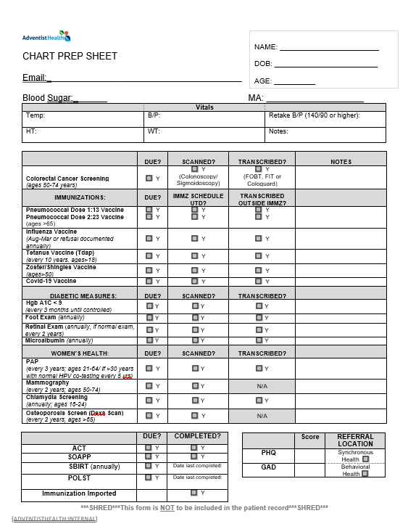
Complex Care Chart Prep Sheet
This form will be completed for each patient
prior to their office visit.

Slide 14
Complex Care Internal Structure
2022

Slide 15
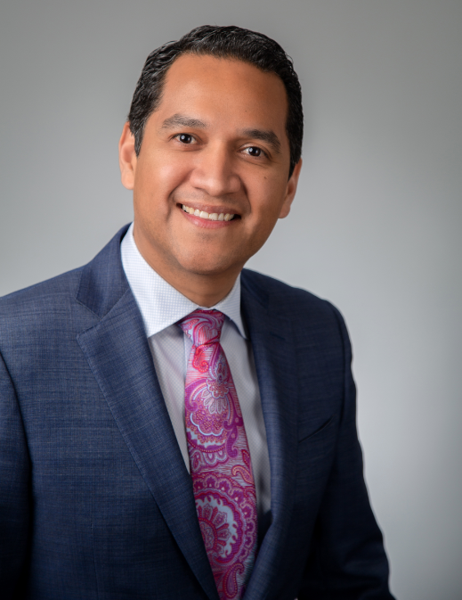
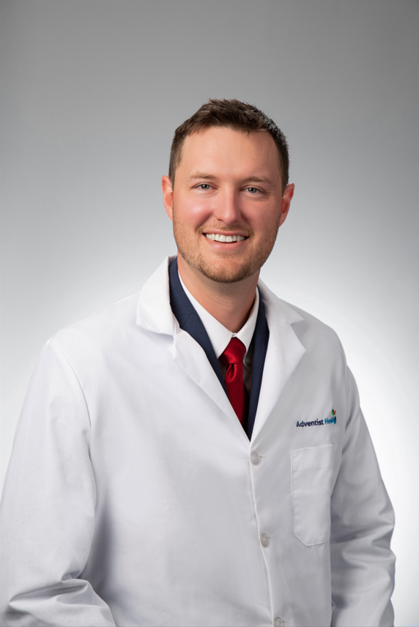
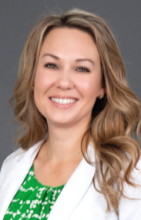
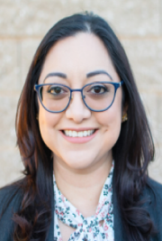
Complex Care Provider Team
Hanford/Selma Complex Care Ambulatory Medical Officer and CCM Leader Dr. Raul Ayala | Hanford Complex Care Dr. Joshua Strunk | Hanford Complex Care Kerry Cromwell, FNP | Selma Complex Care Priscilla Carey, FNP

Slide 16
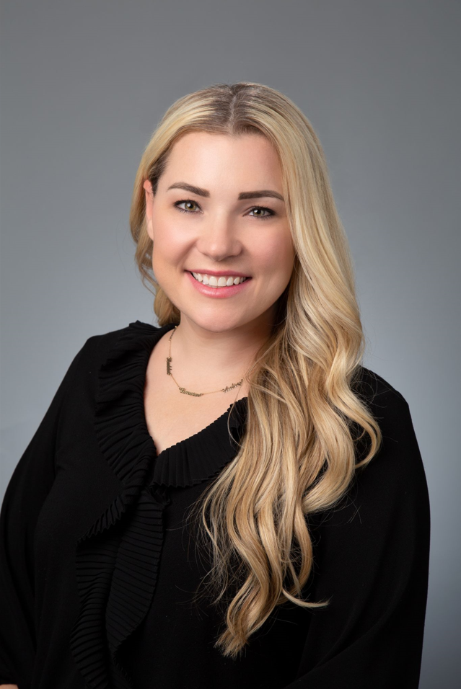
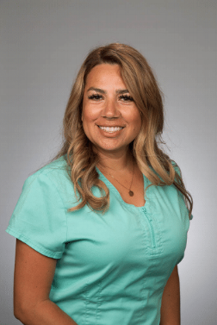
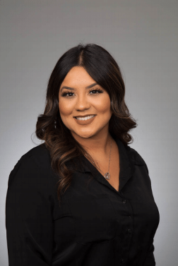
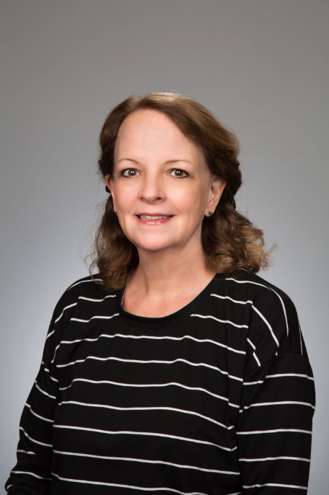
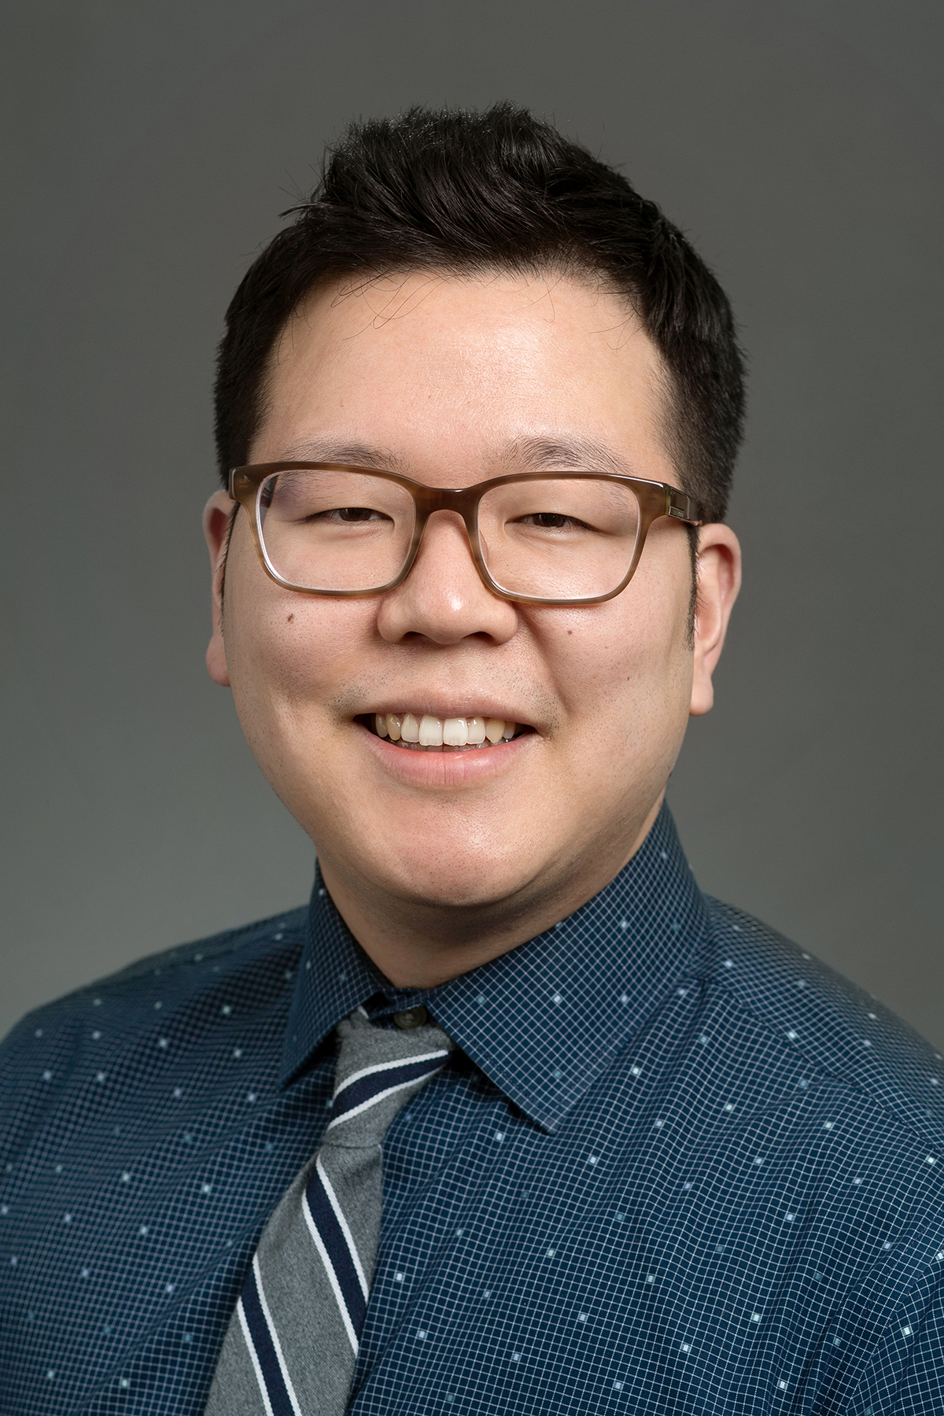
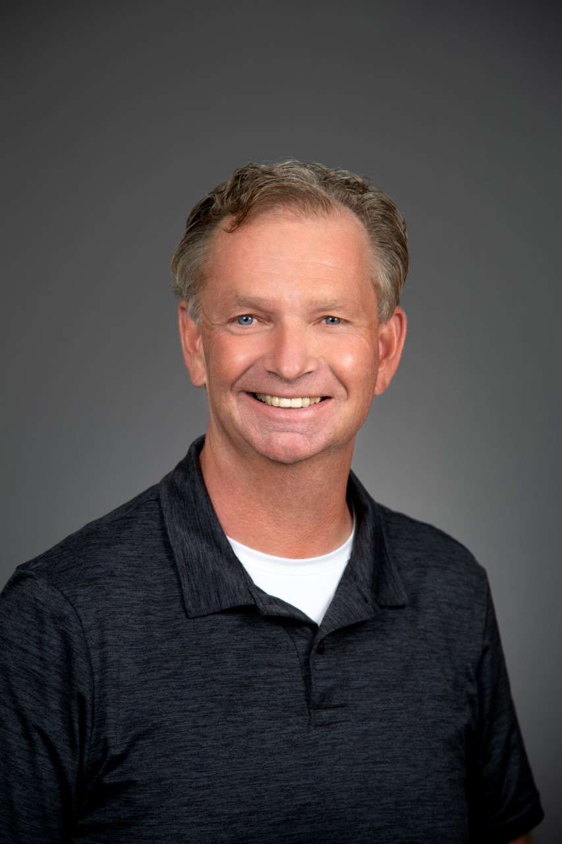
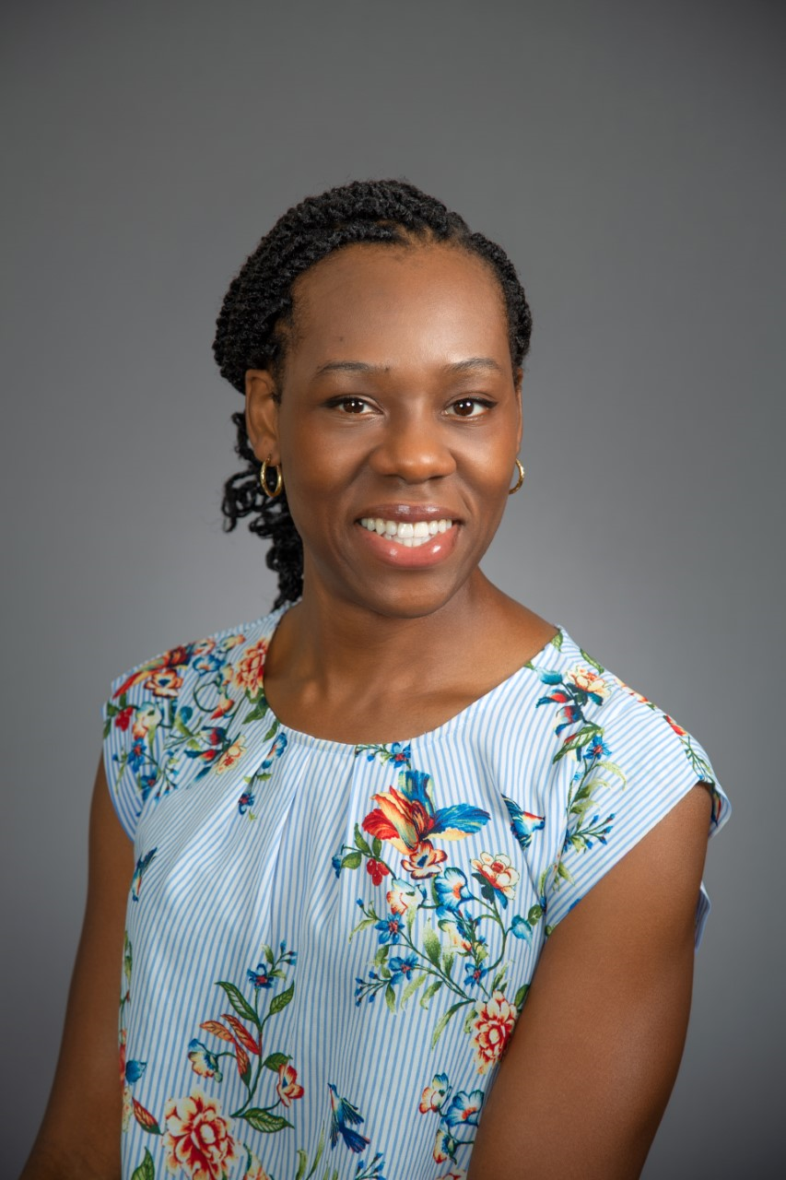
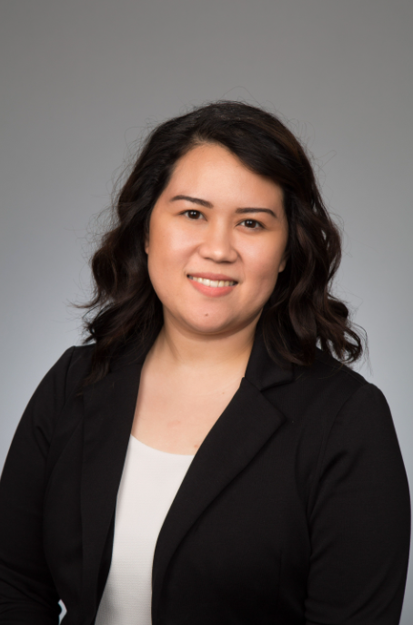
Complex Care Support Team
Phone Number: 559-537-0170
Fax: 559-537-0199
RN Manager: Meredith Alvarado | Lead MA: Adriana McNary | Social Work: Maria Nunez | RN Education: Julie Azevedo
Pharmacy | Clergy: Stan Plooy | Registered Dietitian: Ijeoma Nnadi | Registered Dietitian: Gelline Galgana

Slide 17
Patient
Community
Medical
Specialty
Pharmacy
Patient
Medical
Behavioral
Specialty
Social Work
Spiritual
Pharmacy
Technology
Staff
Community
Monthly Multidisciplinary Rounding

Slide 18
Qualitative Data

Slide 19
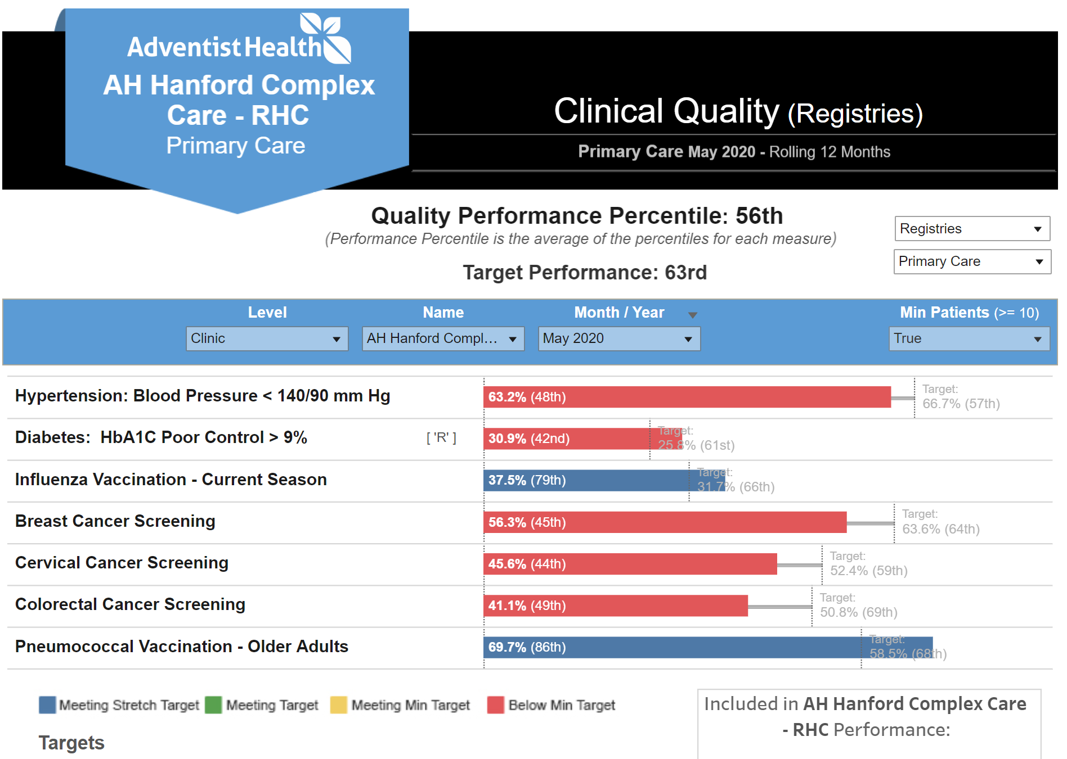
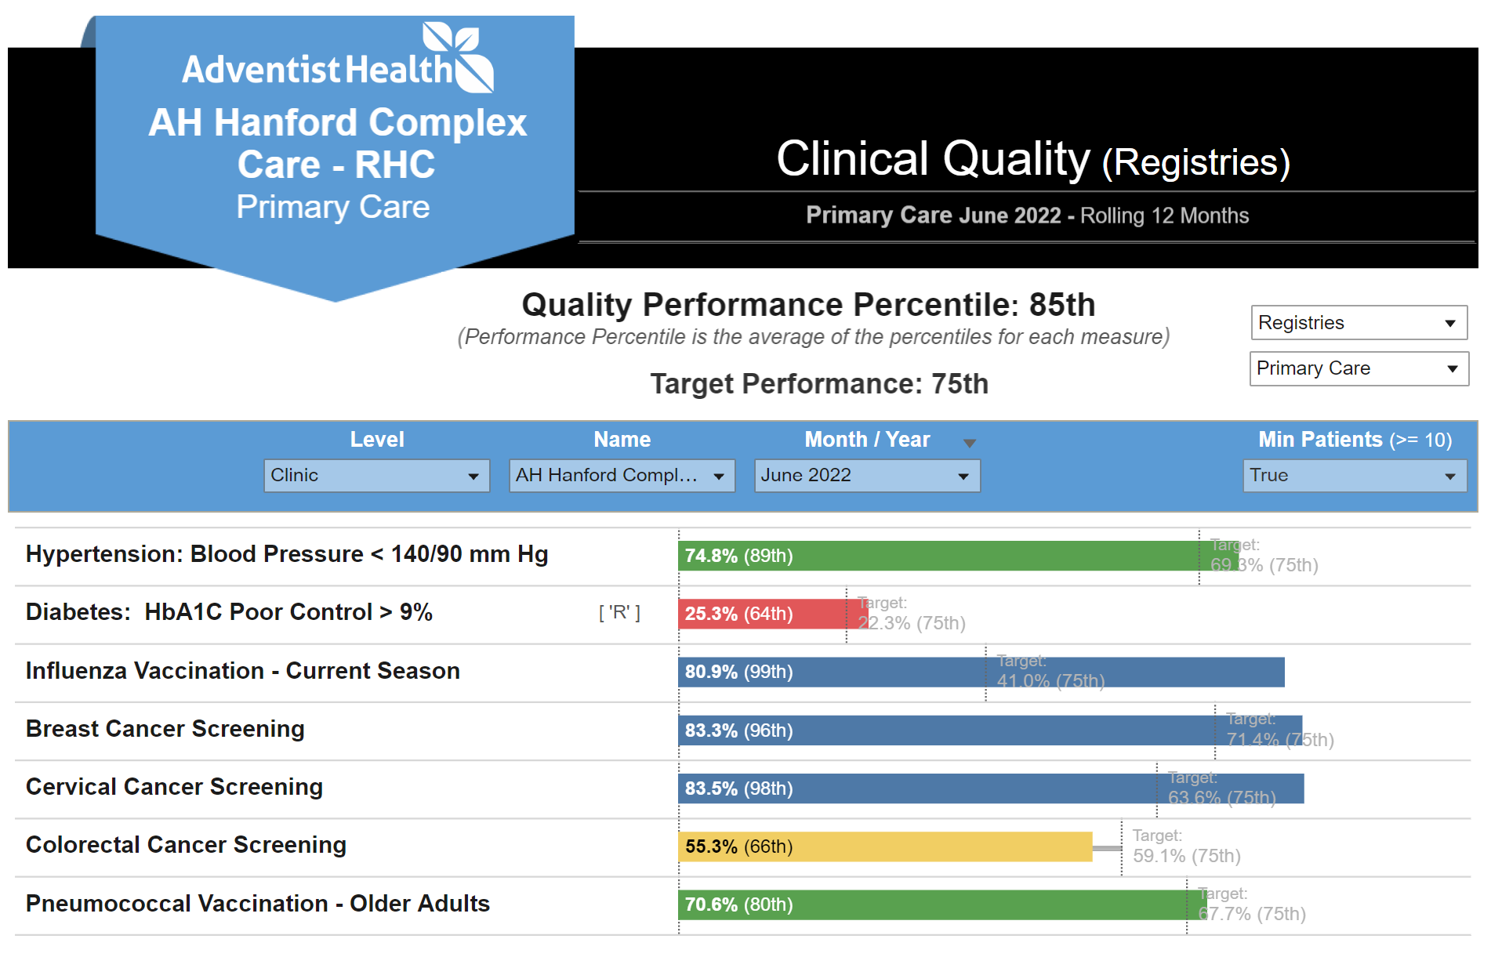

Slide 20
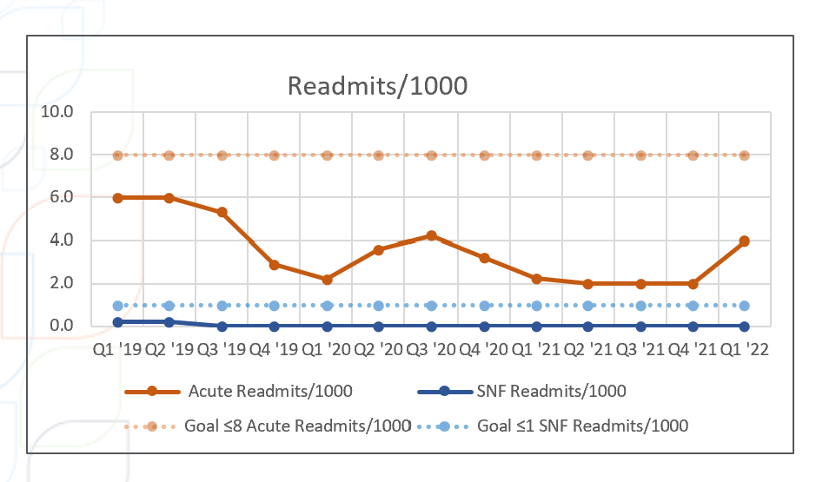

Slide 21
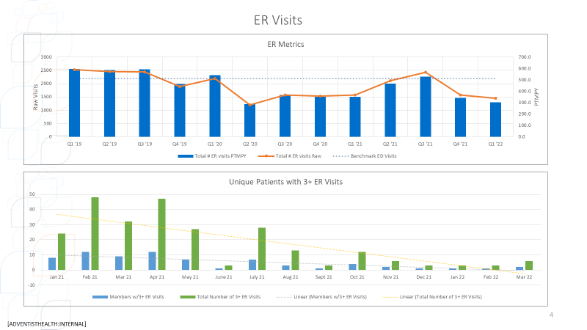

Slide 22
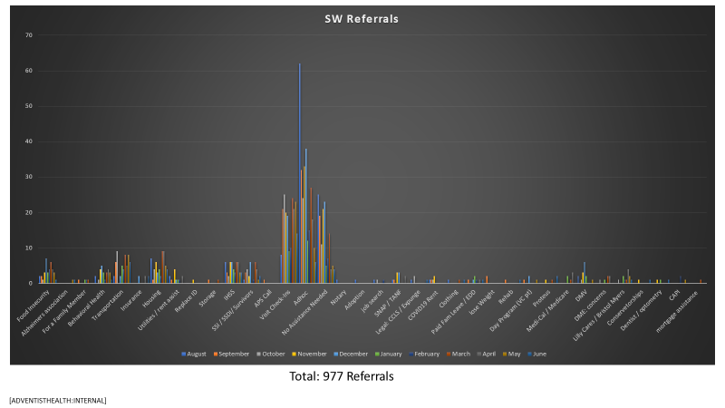

Slide 23
Programs/Grants
Chronic Care Management
Behavioral Health Integration Grant
Medicated Assisted Treatment Program
CORE*REMS Opioid Safe Prescribing Programt
Family Medicine Residency Program
Pharmacy Fellowship Program
ECHO Alzheimer Program

Slide 24
Care Management Services RHCs

Slide 25
Technology

Slide 26
Power of Community

Slide 29
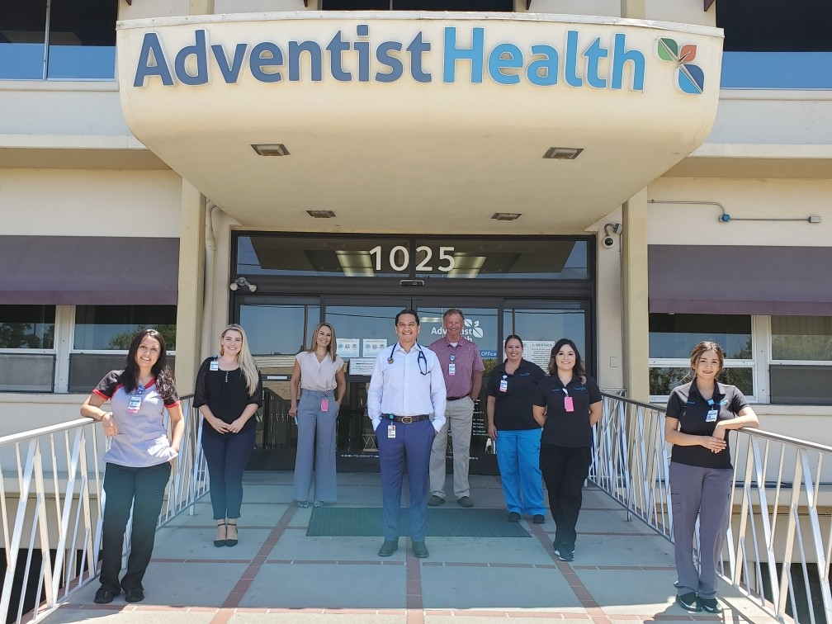
Thank you!
ayalar1@ah.org

Slide 30
References
https://www.dhcs.ca.gov/CalAIM/Pages/calaim.aspx
https://aspe.hhs.gov/topics/behavioral-health/serious-mental-illness-smi
https://agsjournals.onlinelibrary.wiley.com/doi/abs/10.1046/j.1532-5415.2003.51185.x
https://www.ncbi.nlm.nih.gov/pmc/articles/PMC5624113/pdf/ijic-17-4-2944.pdf
https://www.sciencedirect.com/science/article/abs/pii/S0277953612005916
https://jamanetwork.com/journals/jama/article-abstract/2556002
https://www.cdc.gov/dhdsp/policy_resources/pcmh.htm
https://www.ncqa.org/programs/health-care-providers-practices/patient-centered-medical-home-pcmh/process/

