Slide 1

Pesticide Use and Pesticide-Related Illness in California
Alanna Bares, MD, MPH
Pesticide Epidemiology Section
Office of Environmental Health Hazard Assessment (OEHHA)
California Environmental Protection Agency (CalEPA)
CARHC 14th Annual Conference
Folsom, California July 26-27, 2022

Slide 2
Agenda
Introduction to pesticides
Pesticides in CA
Pesticide-related illnesses
Reporting pesticide-related illnesses
Pesticide-related illness prevention

Slide 3

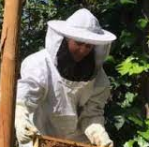



MEET THE TEAM
Pesticide Epidemiology Section
3
Ouahiba
Toxicologist
jing
Research Scientist
James
Toxicologist
ALANNA
Public Health Medical Officer
NANCY
Health Educator

Slide 4
Introduction to Pesticides
Common pests
Classification of pesticides

Slide 5



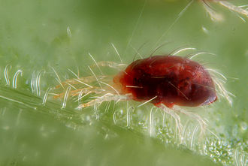
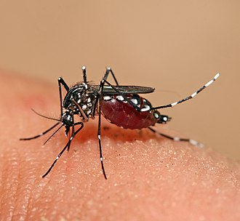
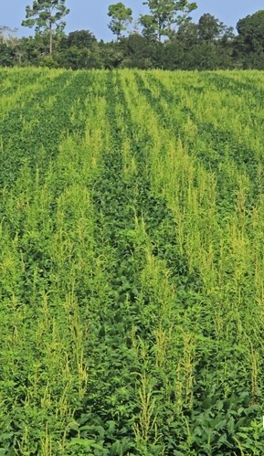
Common Pests
Notes:
A pest is any living organism that causes damage or economic loss or transmits or produces disease.
Common pests include weeds, ants, germs, cockroaches, flies, mice, rats, or termites.
Pests are also virus and bacteria that cause plant diseases.

Slide 6
Classification of Pesticides
By target function:
  Insecticides
  Miticides
  Herbicides
  Fungicides
  Nematocides
  Rodenticides
  Fumigants
  Disinfectants, sanitizers*
  Plant growth regulators
  Insect repellents
By chemical group:
  Organophosphates
  N-methyl carbamates
  Pyrethroids
  Organochlorines
  Neonicotinoids
Notes:
A pesticide is any substance or mixture of substances intended for:
preventing;
destroying;
repelling; or
mitigating any pest
They are classified by target organism or function and by chemical group.
*In California, sanitizers and anti-microbial products not used on or in humans or animals are classified as pesticides.
Products that are NOT considered to be a Pesticide in California:
Over-the-counter and prescription treatments for head lice
Cosmetics and similar products applied to the human body
Fertilizers, nutrients and other substances that promote plant survival and health.
Biological control agents, except for certain microorganisms (birds and beneficial insects)
Plant-incorporated protectants (found in genetically-modified plants)
Certain low-risk substances (garlic or cedar)

Slide 7
Pesticides in California
  Pesticide regulation in CA
  Pesticide use in CA
  Exposure assessment

Slide 8




Pesticide Regulation in California
US EPA
  Registers all pesticides sold or distributed in the United States
  Establishes a maximum permissible level for pesticide residues allowed on food for human consumption and animal feed
California
Notes:
Federal, state and local government agencies all play a role in pesticide use control.
Pesticides are one of the few chemicals that are regulated in the US.
USEPA sets minimum pesticide use standards. It registers (licenses) all pesticides used in the United States and sets highest level of pesticide residues that are allowed on food. Functions under the Federal Insecticide, Fungicide, and Rodenticide Act (FIFRA 1996), which provides for federal regulation of pesticide distribution, sales, and use.
Before EPA may register a pesticide under FIFRA, the applicant must show that using the pesticide according to specifications “will not generally cause unreasonable adverse effects on the environment.”
DPR
California has pesticide regulatory programs wider in scope than any other state.
Department of Pesticide Regulation (DPR) has primary responsibility for pesticide use enforcement in our state.
This authority extends to county agricultural commissioners for local enforcement.
DPR registers pesticides used in California. Any pesticide sold in California must be registered with DPR in addition to USEPA registration.
DPR regulates pesticide sales, use, monitoring, and enforcement in the state.
OEHHA, CARB, SWRCB all play various roles with pesticides and help to support DPR.

Slide 9
DPR’s Pesticide Use Reporting (PUR) Program
The most comprehensive in the world
All “agricultural” use, a broad legal definition:
  Production agriculture
  Postharvest treatments of agricultural commodities
  Watersheds, rights-of-way, landscaped areas
  Treatment in poultry and fish production as well as some livestock application
  Exception: home-and-garden use, most industrial and institutional uses
Notes:
In 1990, California became the first state to require full reporting of ag pesticide use in response to demands for more realistic and comprehensive pesticide use data.
Under this program, ALL ag pesticide use must be reported.
California is the only program where we know when, where, and how much of a pesticide is being used.
Ag use includes pesticide applications to parks, golf courses, cemeteries, rangeland, pastures, along roadside and railroad rights-of-way.
Also, all postharvest pesticide treatments of ag commodities must be reported along with all pesticide treatments in poultry and fish production as well as some livestock applications.
Supplemental data:
DPR’s sales database
Annual self-reporting of total pounds/gallons of product
Pesticide registrants, pest control dealers and pesticide brokers

Slide 10
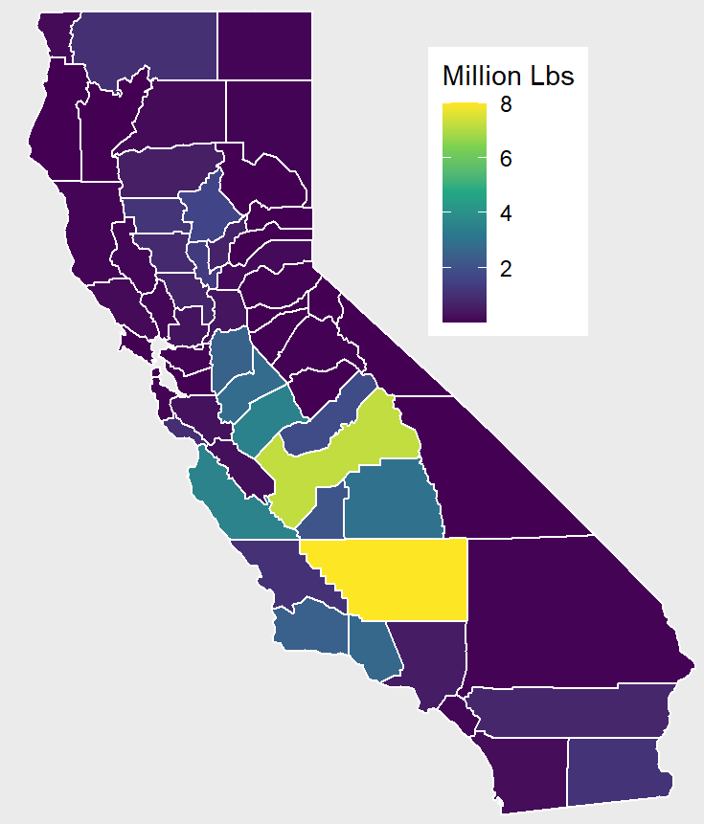
Pesticides Used for
Production Agriculture
Annual average 191 million lbs. in 2015 - 2019
Notes:
Highest use counties include: Kern, Fresno, San Joaquin, Stanislaus, Merced, Madera, Tulare, Kings, Monterey, SB, Ventura
Production agriculture: pesticides intended to contribute to the production of an ag commodity, including livestock.

Slide 11

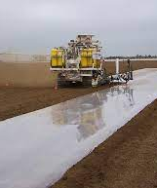



CA Commodities with High Pesticide Use
11
Notes:
Strawberries, almonds, grapes, and carrots are some crops that use the highest amounts of pesticides in California.
Soil fumigation, as shown on the center picture, applies highly volatile chemicals to treat soil before planting crops.

Slide 12
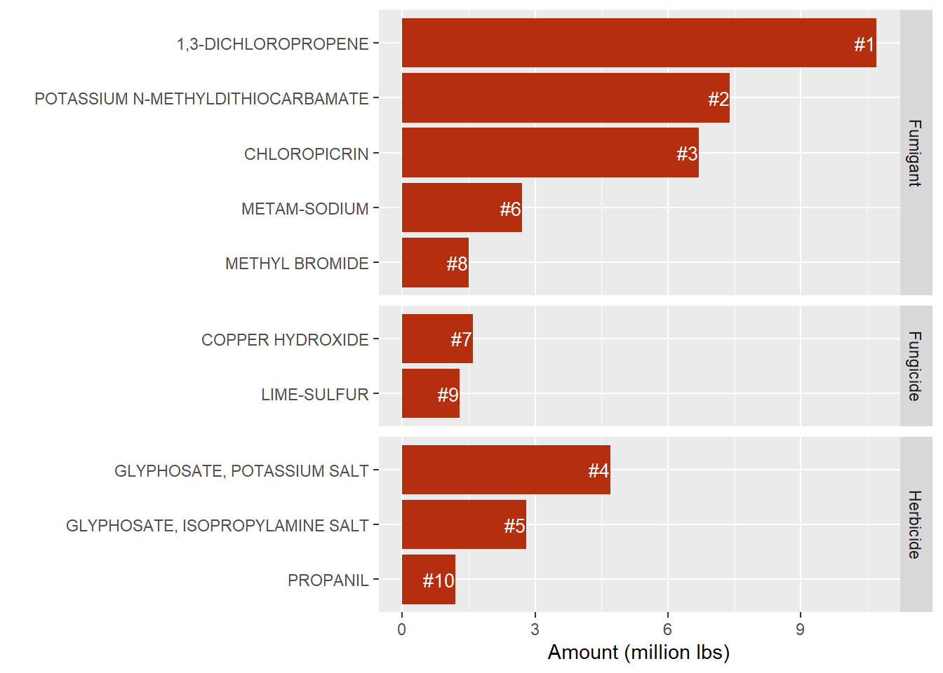
Top 10 Active Ingredients Used for Production Agriculture
Notes:
Let people read the slide first quickly.
Fumigant: any pesticide product that is a vapor or gas, or forms a vapor or gas upon application, and whose pesticidal application is achieved through the gaseous or vapor state. Used on many high value crops and provide benefits to growers in controlling wide range of pests including nematodes, fungi, bacteria, insects, and weeds.
1. 1,3-Dichloropropene: fumigant, nematicide, chemical class-halogenated organic. Used as a soil fumigant. Commonly used for almonds, soil preplant, strawberries, sweet potatoes…
2. Potassium N-Methyldithiocarbamate (Metam Potassium): fumigant, fungicide, algaecide etc. Chemical class- dithiocarbamate-MITC, Used on carrots, tomatoes for processing, sweet potatoes, potatoes…
3. Chloropicrin: fumigant, nematicide, chemical class- inorganic. Uses: strawberries, soil preplant, almonds
4. Glyphosate, potassium salt: herbicide, chemical class- phosphonoglycine, used on almonds, pistachios, cotton, wine grapes, walnuts…
5. Glyphosate, isopropylamine salt: herbicide, chemical class- phosphonoglycine, used on “right of way” aka non-ag, almonds, landscape, uncultivated ag

Slide 13
Pesticides Risk on Human Health
How toxic is the chemical?
How much exposure is there?
Risk = Toxicity x Exposure
Notes:
Human risk assessment for pesticides: hazard identification, dose-response assessment, exposure assessment, and risk characterization.
Risk=Toxicity x exposure
For exposure, we want to know how much, how often, the route of exposure, individual conditions (sensitive populations, comorbidities)
Most common routes of exposure to pesticides= inhalation, ingestion, and dermal absorption

Slide 14
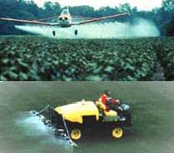
Occupational Pesticide Exposure Scenarios
Pesticide handlers - by direct contact
Field workers – exposure to residues on plant leaves and produce
Drift or off-target movement of applied pesticides through air
Handling of pesticide containers that haven’t been de-contaminated
Most occupational pesticide illnesses are due to dermal exposure
Notes:
Non-occupational exposures: pesticide use in schools, lawn and garden use, household cleaning, home-use pesticides, improper pesticide storage and transfer to other containers, leading to unintentional poisonings

Slide 15
California-specific Exposure Assessment
Pesticide-related illness
Application scenarios based on PUR
  Region, use amount, use acreage, application method
Inhalation: air concentrations
Ingestion: food intake & residue
  Commodity
  Drinking water
Notes:
Maybe skip.
Pesticide-related illness is reportable condition.
Air monitoring
Air modeling
Food intake: The National Health and Nutrition Examination Survey/“What We Eat in America” (NHANES/WWEIA)
Pesticide residues in food: USDA Pesticide Data Program
Exposure assessment: US EPA Dietary Exposure Evaluation Model

Slide 16
Pesticide-Related Illnesses
  Diagnosis & Pesticide Exposure History
  Case Scenarios & Treatment

Slide 17
Key Points for Diagnosis
Few
tests or
therapies
Hard to Diagnose
Can resemble flu or gastroenteritis
Exposure History
Notes:
For most pesticide poisonings, there are no diagnostic tests or specific therapies.
Thus, pesticide illnesses can be difficult to diagnose.
The exposure history is the most important information the physician needs to make the correct diagnosis. If you don’t ask if the patient has or might have had exposure to pesticides, (asking for their occupation for example) you may not associate their symptoms to pesticide-related illnesses. Symptoms are often non-specific and can look like common illness, including gastroenteritis and viral syndromes.
Consider also that workers can be exposed to chemicals and not be aware of it.
If any of these questions are answered in the affirmative, then a more detailed exposure history should be taken.

Slide 18

Exposure History
Do his symptoms match known pesticide effects?
What chemicals were you using?
How did this happen? How long were you exposed?
When did this happen? When did you first notice these symptoms?
Notes:
If the patient was in fact exposed to a pesticide, some questions that need to be answered include:
What was the pesticide?
What was the exposure?
Was the exposure sufficient to cause the signs and symptoms?
Were the signs and symptoms consistent with the known effects of the pesticide?
When did the exposure happen and when did the signs and symptoms occur?
Was personal protective equipment (PPE) used and was it working properly?
Also consider household exposures for spouses or other family members. “What is your occupation and that of other household members?” “Has anyone in the family worked with hazardous materials that they might have brought home (e.g. pesticides, asbestos, lead)? (If yes, inquire about household members potentially exposed.)
The physician should consider a visit to the worksite.

Slide 19

Examples of Occupational Screening Questions
Are you exposed to toxic chemicals at your job? Are you exposed to any other chemicals at work or at home?
Do your symptoms seem to be related to anything at work?
Do your co-workers have the same or similar symptoms?
Please tell me more about your specific job duties. And what about your previous jobs – were you also exposed to chemicals there?
Notes:
As in the previous slides, these questions are seeking more information about possible sources of pesticide/chemical exposure and how they might be related to the patient’s job.
An occupational medicine history incorporates routine screening questions such as:
Does the patient’s occupation involve an exposure to toxic chemicals?
Exactly what are the specific job duties (not just the job title)?
Do other co-workers have the same or similar symptoms?
Are the symptoms related to anything at work?
Are the symptoms worse at work, and do they improve when off work or on vacation?
Are there exposures to other chemicals at work or in the home?
What are the patient’s past occupations and exposures?
If any of these questions are answered in the affirmative, then a more detailed exposure history should be taken.

Slide 20
Routes of Exposure
Inhalation
      Fastest
Ingestion
      Frequently used in self-harm attempts
      Most common route for children
  Dermal absorption
      Slower
      Symptoms may not appear for 6-12 hours after exposure
      Most common route for occupational exposures
Notes:
20
The most common routes of pesticide exposure are inhalation, ingestion and dermal absorption
Dermal absorption: Patients with significant exposures should be observed for at least several hours.

Slide 21
Case Scenarios
  Soil Fumigation and Off-Site Drift
  Field Workers Poisoned by Pesticide Residues
Notes:
Let’s review two examples of pesticide-related illness incidents. Both reflect the pesticide-intensive nature of production agriculture common in California.

Slide 22
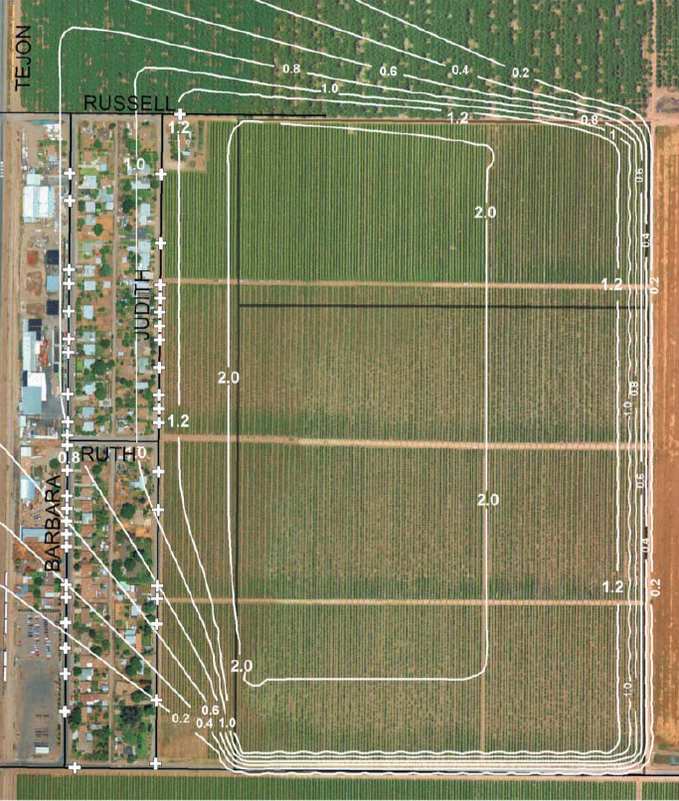
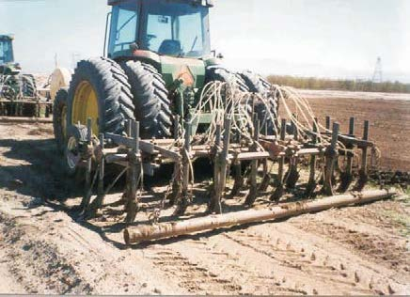
Case Study 1
Vapors from a soil fumigation make the neighbors sick (Arvin, CA)
Notes:
Fumigant: any pesticide product that is a vapor or gas, or forms a vapor or gas upon application, and whose pesticidal application is achieved through the gaseous or vapor state. Used on many high value crops and provide benefits to growers in controlling wide range of pests including nematodes, fungi, bacteria, insects, and weeds.
Soil fumigants percolate through the soil - eliminating many plant pathogens before crops are planted. However, these applications can expose nearby workers and residents to harmful levels of pesticides. In 2002, residents in Arvin were exposed to vapors from soil fumigants.
In the photo on the left, you can see a soil fumigation rig that injects fumigants below the surface.
The photo on the right shows that the homes (visible along the L side) located only a few hundred feet away from the treated field. So when the wind direction shifted in the late afternoon, nearly 200 residents were exposed almost immediately. The contour lines show estimated air concentrations of the pesticide emissions in parts per million.
Remember: Risk=Toxicity x exposure
Fumigants move from soil to air at the application site and can then move off site. These vapors can affect nearby residents or workers.
There was a 500 ft buffer zone between the homes and the field.
The application ended before 4 pm and the wind began to push vapors towards the residents about 7 pm.
Estimated peak air concentrations occurred later that evening between 8 pm and midnight.

Slide 23
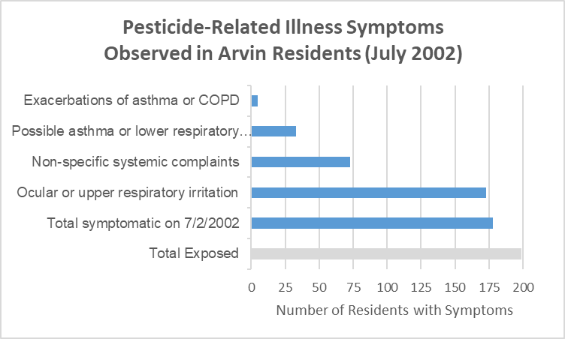
Symptoms Observed in Residents
O’Malley et al, (2005)
Notes:
About 178 of 200 (~89.4%) exposed residents reported to be symptomatic.
As you can see, most of the residents reported eye or upper respiratory symptoms (97%).
Roughly 40% had non-specific symptoms (headache, nausea, vomiting)
About 18.5% reported asthma or lower respiratory irritation.
5 residents had pre-existing asthma or COPD.
Who Sought Treatment?
7/73 cases – non-specific symptoms (nausea, vomiting, headache)
6/33 cases – possible asthma & lower respiratory irritation
1 person was hospitalized x 1 week due to respiratory distress, was discharged home on oxygen.
This highlights the concern for exposure to sensitive populations, young children, elderly, people with comorbidities (ie. Asthma, copd, cld)

Slide 24
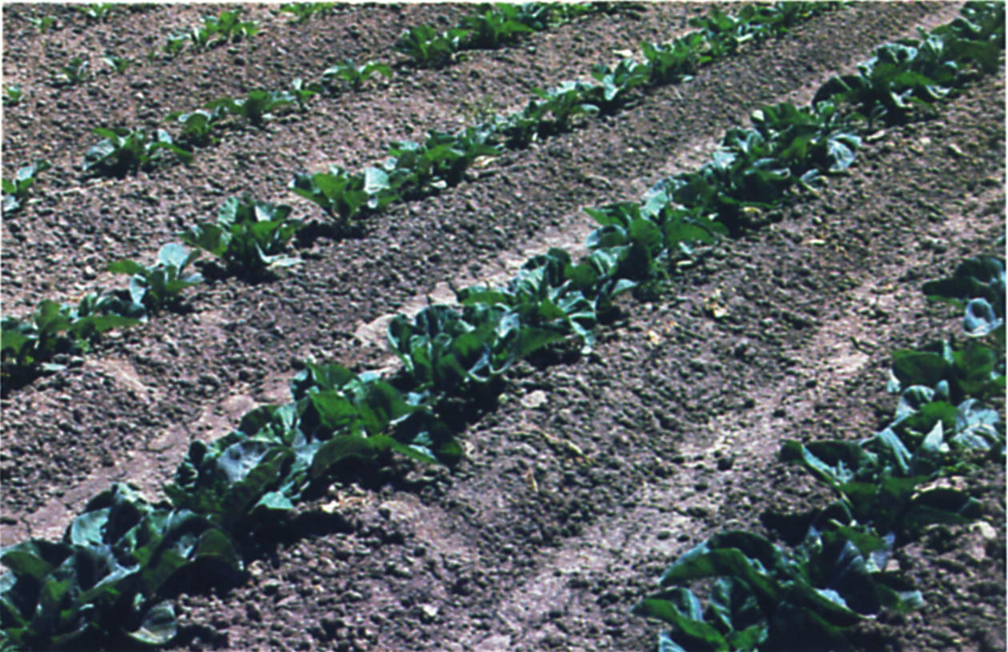
Case Study 2
Pesticide residues put
16 farm workers in the hospital
Notes:
6 hours after highly toxic organophosphate pesticides (mevinphos and phosphamidon) were applied, 23 farm workers entered a cauliflower field. Regulations restricted re-entry into the field for 72 hours.
16/23 (~70%) of the exposed sought care and were hospitalized.
2 hours later, a few workers noticed blurred vision and eye irritation, then a few more developed dizziness, weakness, disorientation, headache, nausea, and vomiting. Several had bad cramping of arms, legs, and stomach. 2 workers collapsed with bradycardia, and had increased salivation, miosis, and muscle fasciculations.

Slide 25
Signs and Symptoms of OP/Carbamate Poisoning
SLUDGE/BBB
Salivation
Lacrimation
Urination
Defecation
Gastrointestinal pain
Emesis
Bradycardia, Bronchorrhea, Bronchospasm
Primary cause of death is Respiratory Failure
Notes:
Many more signs and symptoms not listed here on this slide.
ChE inhibitors can affect 3 major classes of AChE receptors throughout the body, muscarinic, nicotinic, and CNS receptors.
As you may already know, certain symptoms are classically associated with ChE inhibition (the SLUDGE and DUMBELS acronym)
SLUDGE/BBB
Salivation (excessive)*
Lacrimation*
Urination*
Defecation or Diarrhea*
Gastrointestinal upset
Emesis
DUMBELS
Defecation
Urination
Miosis
Bradycardia, Bronchorrhea, Bronchospasm
Emesis
Lacrimation
Salivation
Nicotinic Effects can be remembered by MTWThF acronym:
Mydriasis/muscle cramps
Tachycardia
Weakness
Twitching
Hyperglycemia/HTN
Fasciculations
CNS signs/symptoms: headache, anxiety, confusion, psychosis, ataxia, seizures, AMS, coma, respiratory depression
Respiratory status should be evaluated and monitored carefully. Bronchospasm and bronchorrhea in combination with weakness of the respiratory muscles and depression of medullary respiratory centers can cause respiratory arrest (can be sudden)
Respiratory failure due to weakness of respiratory muscles, central respiratory depression, bronchorrhea etc.

Slide 26
Differential Diagnosis
Mild cases
  Acute viral syndromes (flu-like illness)
  Gastroenteritis
  Respiratory infections
  Asthma
  Psychological dysfunction
  Allergic dermatitis
Severe Cases
  Acute cerebrovascular accident
  Heat stroke
  Heat exhaustion
  Epilepsy
  Infections
    Meningitis
    Encephalitis
    Pneumonia
  Psychosis

Slide 27
Management of Seriously Poisoned Patients (Hospital Setting)
Supportive Care
  Endotracheal intubation and mechanical ventilation for oxygenation and to prevent aspiration
Decontamination concurrently
  Clothes removed and bagged (dispose of shoes)
  Completely wash patient (skin, skin folds, scalp, under fingernails) with water and soap or an alkaline detergent (flush eyes if indicated)
Medications
  Anticholinergic medication is mainstay of treatment
    Atropine sulfate, administered IV, or IM (if IV not available)
  Cholinesterase reactivator
    Pralidoxime (2-PAM, Protopam)
    Adults and children >12 years: by IV infusion
Roberts & Reigart (2013). Recognition and Management of Pesticide Poisonings, 6th Ed
Notes:
Supportive care, esp of respiratory system, very important.
Atropine:
Atropine competitively blocks acetylcholine at muscarinic receptors (no effect on nicotinic receptors, including respiratory muscles). First dose is a “test dose” to see if there is a response suggesting OP/Carbamate poisoning. End points for adequate atropinization include lung sounds are clear, improved bronchorrhea/secretions, reversal of muscarinic signs and symptoms, full atropinization includes flushing, dry mouth, mydriasis, tachycardia.
Given IV/IM, may need continuous infusion. Atropine toxicity can cause fever, muscle fibrillation, delirium.
2-PAM:
Reactivates acetylcholinesterase by removal of the phosphate group bound to the esteratic site
Draw blood sample for cholinesterase testing before administering pralidoxime
Most effective before “aging” occurs. Within the first 6 hours after exposure to OP but reported efficacious up to 24-48 hrs. later.
Given IV.
Caution: Persons attending victim should avoid direct contact with heavily contaminated clothing and vomitus. Wear rubber gloves while washing pesticide from skin and hair. Vinyl gloves provide no protection from dermal absorption.
GI measures: Activated charcoal. For the unconscious, intubate the airway for protection. Then gastric lavage with a large bore tube followed by use of charcoal
Furosemide for persistent pulmonary edema after full atropinization
Hydrocarbon aspiration. Treat as ARDS
Monitor cardiac and pulmonary status (chest x-ray, EKG and cardiac monitoring if indicated)
Seizures: Diazepam or lorazepam
**monitoring ChE blood levels/Follow-up until normalize (reach >80% of baseline)

Slide 28
Reporting Pesticide-Related Illnesses in CA
  How to report
  Data
  Limitations

Slide 29
Pesticide-illness Reporting in California
Known or suspected pesticide-related illness or injury is a “reportable disease” (Title 17 of the California Code of Regulations).
Just like communicable disease reporting, health care providers play a key role in pesticide-related illness reporting to state and local authorities.
Notes:
As most of you know, California requires providers to report certain diseases and medical condition - many communicable diseases that fall under this “reportable disease” mandate.
Many of you may not know that “Known or suspected pesticide-related illness or injury” is also a “reportable condition” and therefore must be reported.
The California health and safety code of laws (HSC 105200) specifies who has to report, what to report, to whom to report, and when to report pesticide illnesses.

Slide 30

Who must report
Physicians and surgeons
What to report
Any known or suspected case of pesticide-related illness or injury
Notes:
Physicians and surgeons must report any known or suspected case of pesticide-related illness or injury.
Other health care providers should also report following the same reporting procedures.
*Any case that is suspicious for pesticide-related illness should be reported. It is NOT up to the provider to confirm the diagnosis. All cases that are reported are investigated.

Slide 31


To Whom
When
Local Health Officer
Within 24 Hours
Notes:
To whom must they report? To the Local Health Officer.
When shall they report it? Within 24 hours

Slide 32


How?
Local Health Officer or Designee
California Poison Control Center
Confidential Morbidity Report
CalREDIE California Reportable Disease Information Exchange
Notes:
To report a pesticide illness, CA physicians must use one of the following four methods :
Calling the local health officer or the LHO designee. CCLHO Health Officer Directory (ca.gov)
Calling the CPCS. 1-800-222-1222 for general public. For healthcare providers 1-800-411-8080. Will make the report for you.
Filing a CMR (Confidential Morbidity Report or
Report electronically using CalREDIE, the California Reportable Disease Information Exchange if it is available in the physician’s county.
If the physician fails to comply, they shall be liable for a $250 civil penalty

Slide 33



Reporting a
Work-Related Pesticide Illness
Doctor’s First Report of Occupational Illness or Injury
5 Days
or
Employer
Insurer
7 Days
Local Health Officer
Notes:
But physicians must also send a copy of the Doctor’s First Report of Occupational Injury or Illness
to the employer or insurer within 5 days of the first visit and
to the Local Health Officer within 7 days of the first visit.

Slide 34
Does Reporting Reduce Excessive Exposure?
Pesticide Use
Surveillance & Investigation
Detect & Report
Modify regulation, label, permit conditions, or other³
Potential Exposure
“Unreasonable adverse effects to people or environment?” ³
³ “A Guide to Pesticide Regulation in California” (DPR, 2017)
Notes:
You might be wondering – “Why are providers required to report pesticide-related illnesses?”
Similar to our efforts to control of communicable disease, the purpose of reporting is to reduce future harmful incidents. And in the recent past, there have been single incidents where pesticide applications have made dozens or hundreds of people ill.
As you can see in this diagram,
any pesticide use can potentially lead to human exposure and detectable illness.
Subsequent investigation and long-term surveillance may lead state regulators to conclude that certain pesticides or application methods can cause “Unreasonable adverse effects….”
and changes must then be made to reduce or prevent the harmful exposure.
*The system helps to identify a) improper use, which can result in a fine or b) proper use, which may trigger need to change labels, use conditions etc.
Specific factors that may trigger reevaluation include
public or worker health hazard,
fish or wildlife hazard,
environmental contamination,
unwanted damage to plants,
inadequate labelling,
lack of efficacy,
disruption of pest management,
availability of an effective and feasible alternative materials or procedure which is demonstrably less destructive to the environment,
discovery that data on which DPR relied to register a product is false, misleading or incomplete
or other information suggesting a significant adverse risk

Slide 35
Some Causes of Underreporting
Non-specific symptoms that resemble other diseases
Physicians who are unfamiliar with pesticide effects
Investigations that fail to identify the pesticide
Difficulty in identifying and tracking chronic effects
Providers that are reluctant or unable to report incidents
Lack of a universal, mandatory legal duty to report incidents
Lack of a central reporting point for all incidents
CA
Recognition and Management of Pesticide Poisonings, 6th ed
Notes:
(OPP Report on Incident Information; US EPA, 2007)
Like many illnesses linked to environmental exposures, pesticide poisonings remain commonly under-diagnosed due in large part to barriers in seeking care and diagnosis of pesticide poisonings.
Estimated that only 10% of cases are actually reported.
Seeking Care
Patient does not recognized symptoms as pesticide-related.
exposed person does not, or is unable to, seek medical attention (may be accustomed to low-level exposure scenarios on the job.)
Other barriers to care: inability to take off from work, transportation problems, language and cultural barriers, lack of health insurance, scarcity of available
community health services and fear of losing employment.
Diagnosis
Difficult diagnosis to make
The clinician may neglect to take an environmental and occupational exposure history
Few diagnostic tools are available.
Lack of awareness and training on pesticide-related illnesses
Not knowing, inability, or reluctance to report pesticide illness

Slide 36
Illness Prevention
  General dos and don’ts
  The California Medical Supervision Program
Notes:
Let’s go over some basic general actions we recommend to prevent over-exposure to pesticides both for farmworkers and home users.
Illness prevention at the individual level.
Illness prevention at the local, state, federal level. An example is the Ca Medical Supervision Program.

Slide 37


General dos and don’ts
Notes:
There are many resources available on pesticide safety and prevention that clinicians can share with their patients. These are from government (here, DPR), academia, and advocacy groups. They are usually available in both Spanish and English and sometime also in other languages. Format varies, they can be factsheets, pamphlets, or even videos.

Slide 38

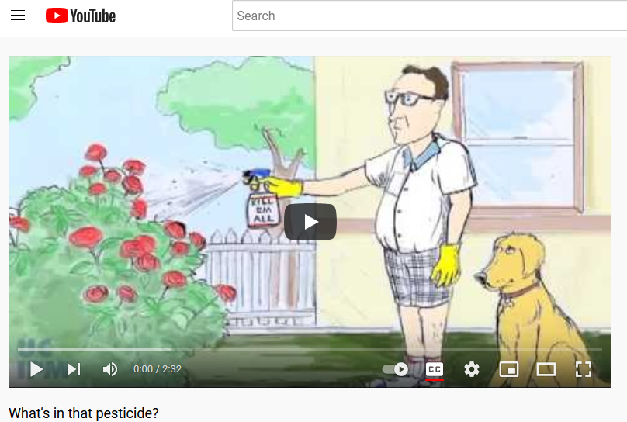

Notes:
All these resources emphasize the importance of reading the label, using only what is allowed, and disposing the pesticide according to the label. Also, wearing appropriate personal protective equipment, and washing hands and clothes after use.
Some tips that may seem obvious but because they are frequently the cause of poisonings include: 1/ never mix different cleaning products together, 2/ never store pesticides in food or beverage containers, and 3/ always store in labeled containers, if not using the original container.
A couple tips in relation to children : 1/pesticides must be kept out of reach of children at all times and 2/ never allow children into recently treated areas.

Slide 39

California Medical Supervision Program
Why?
To protect pesticide handlers who work with the most toxic cholinesterase inhibiting pesticides.
How?
By monitoring blood cholinesterase activity levels.
Notes:
Pesticide illness prevention program: Designed to protect certain pesticide handlers who work with the most toxic cholinesterase inhibiting pesticides by monitoring blood levels to prevent excessive exposure to those pesticides.
Medical Supervisor Physicians are required to possess a copy of and be aware of the contents of the document, “Guidelines for Physicians Who Supervise Workers Exposed to Cholinesterase-Inhibiting Pesticides.”
Cholinesterase inhibiting pesticides: organophosphates and carbamates
Most toxic (Toxicity Categories I and II) : Danger and Warning on label
Blood ChE= surrogate for brain ChE--to prevent a cumulative inhibition of brain cholinesterase activity.
At the end, not that many employees check all the boxes. We estimated about 1200-1500 in California

Slide 40
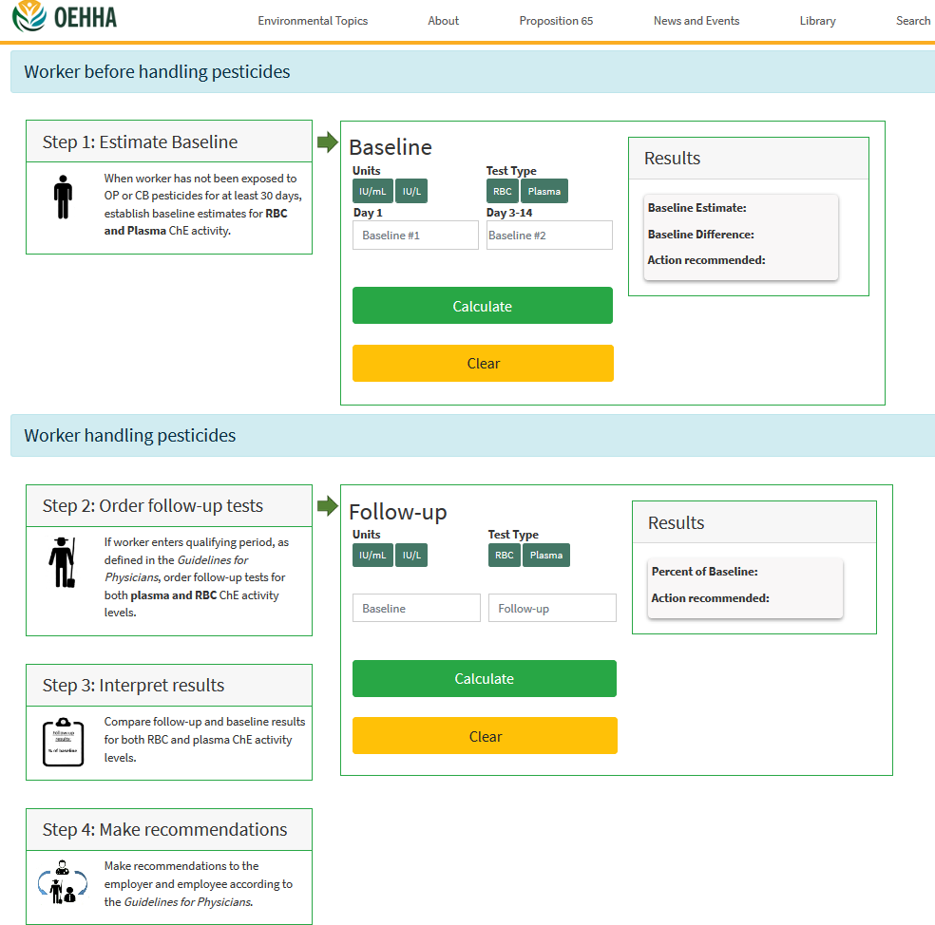
Notes:
On its website, OEHHA provides a calculator and a flow chart to assist Medical Supervisors in calculating cholinesterase activity levels.
Walk through the steps of the calculator to describe how the program works.
Estimate baseline: always order both plasma and RBC cholinesterase tests. Send samples to state certified labs.
Order follow up tests.
Interpret Results.
Make recommendations.

Slide 41

Recommendations Based on ChE Levels
When must the worker stop handling these pesticides:
When can the worker resume handling these pesticides:
If levels return to 80% or more of worker’s baseline for both plasma and RBC
If ≤ 70 % of RBC OR if ≤ 60 % of plasma baseline values
*Note: workers can continue working in other capacities
Notes:
If < 80 % of either plasma or
RBC baseline values
Conduct a review of the workplace environment, safety equipment used and its condition, and employee work practices
If ≤ 70 % of RBC OR if ≤ 60 % of
plasma baseline values
Workers can continue working, but they must stop handling cholinesterase-inhibiting pesticides

Slide 42
OEHHA’s Health Education Resources
Online Course Provide CME Credits (Free!) on Recognition, Management and Reporting of Pesticide Illness
https://oehha.ca.gov/pesticides/clinician-trainings
Health Education Materials
https://oehha.ca.gov/pesticides/health-education-resources

Slide 43
The End
Contact Information
Email: Alanna.Bares@oehha.ca.gov
Phone: 916-323-8808

Slide 44
On-Line Sources of Information
Recognition and Management of Pesticide Poisonings, 6th Edition
(J.R. Roberts and J.R. Reigart, 2013)
  https://www.epa.gov/pesticide-worker-safety/recognition-and-management-pesticide-poisonings
  5th edition available in Spanish
    https://espanol.epa.gov/seguridad-laboral-al-usar-pesticidas/reconocimiento-y-manejo-de-los-envenenamientos-por-pesticidas
National Pesticide Information Center
  Phone: (800) 858-7378
  http://npic.orst.edu
California Department of Pesticide Regulation, Pesticides and Human Health Information
  http://www.cdpr.ca.gov/docs/dept/quicklinks/humanhea.htm

Slide 45
California Government Sources of Information
Department of Pesticide Regulation
    Worker Health and Safety Branch: 916-445-4222
    www.cdpr.ca.gov/docs/whs/whs_homepage.htm
Department of Public Health, Occupational Health Branch
    Occupational Pesticide Illness Prevention Program: 800-970-6680
    https://www.epa.gov/pesticide-worker-safety/recognition-and-management-pesticide-poisonings
Office of Environmental Health Hazard Assessment
    Pesticide and Environmental Toxicology Branch: 510-622-3170
    www.oehha.ca.gov/pesticides
California Medical Supervision Program Calculator
  https://oehha.ca.gov/pesticides/general-info/medical-supervisor-calculator
Notes:
45

